Slide 1
Kristiina Tammets
LAG Tartu County Development Association

Slide 2
VIDEO
Notes:
21 raami

Slide 3
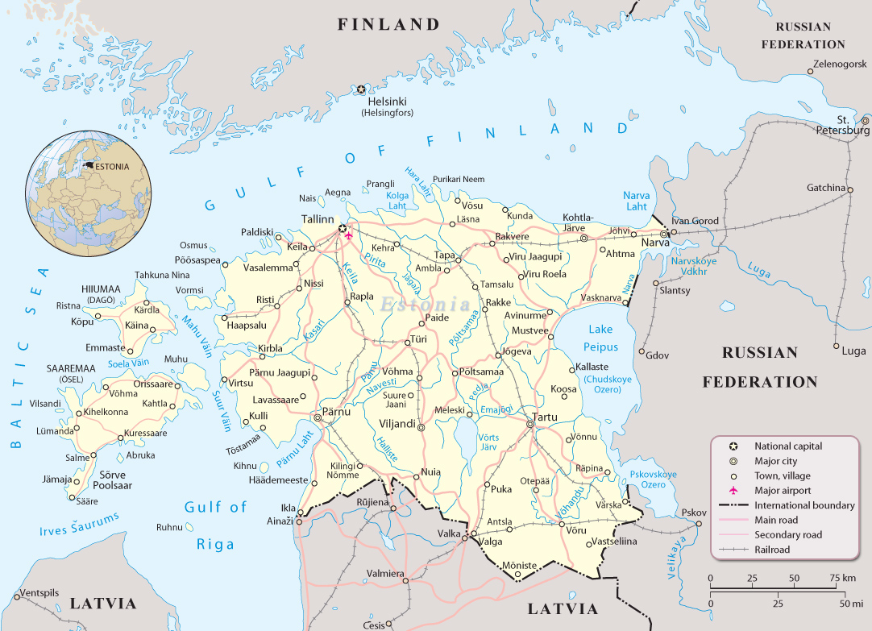

Slide 4
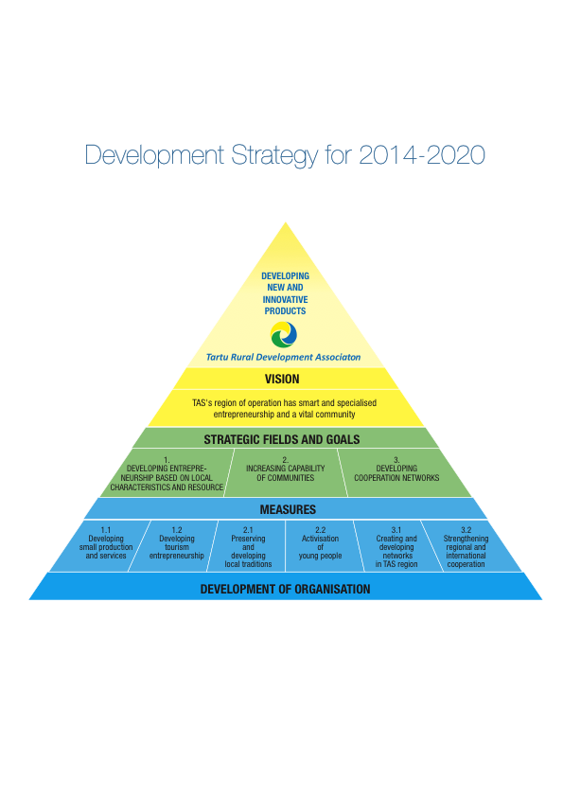

Slide 5
Our local and global challenges today
Expanding the network internationally (Northern Ireland, Latvia, Finland, Czech Republic);
Contributing to the Tartu city application for cultural capital of Europe 2024;
Establishing cooperation with secondary airports in Europe and in China;
Developing new cooperation network on the coastline of river Emajõgi;
Continuous training activities for local stakeholders.

Slide 6
Purposes and values of the project
Purposes
To strengthen regional identity
To make region well-known and bring visitors from other places in Estonia and aboard
To develop innovative products and services
Values
Beautiful nature
Diverse culture and national traditions
Local food and natural products
Active holidays and healthy lifestyle
Sustainable and innovative entrepreneurship

Slide 7









Project partners

Slide 8
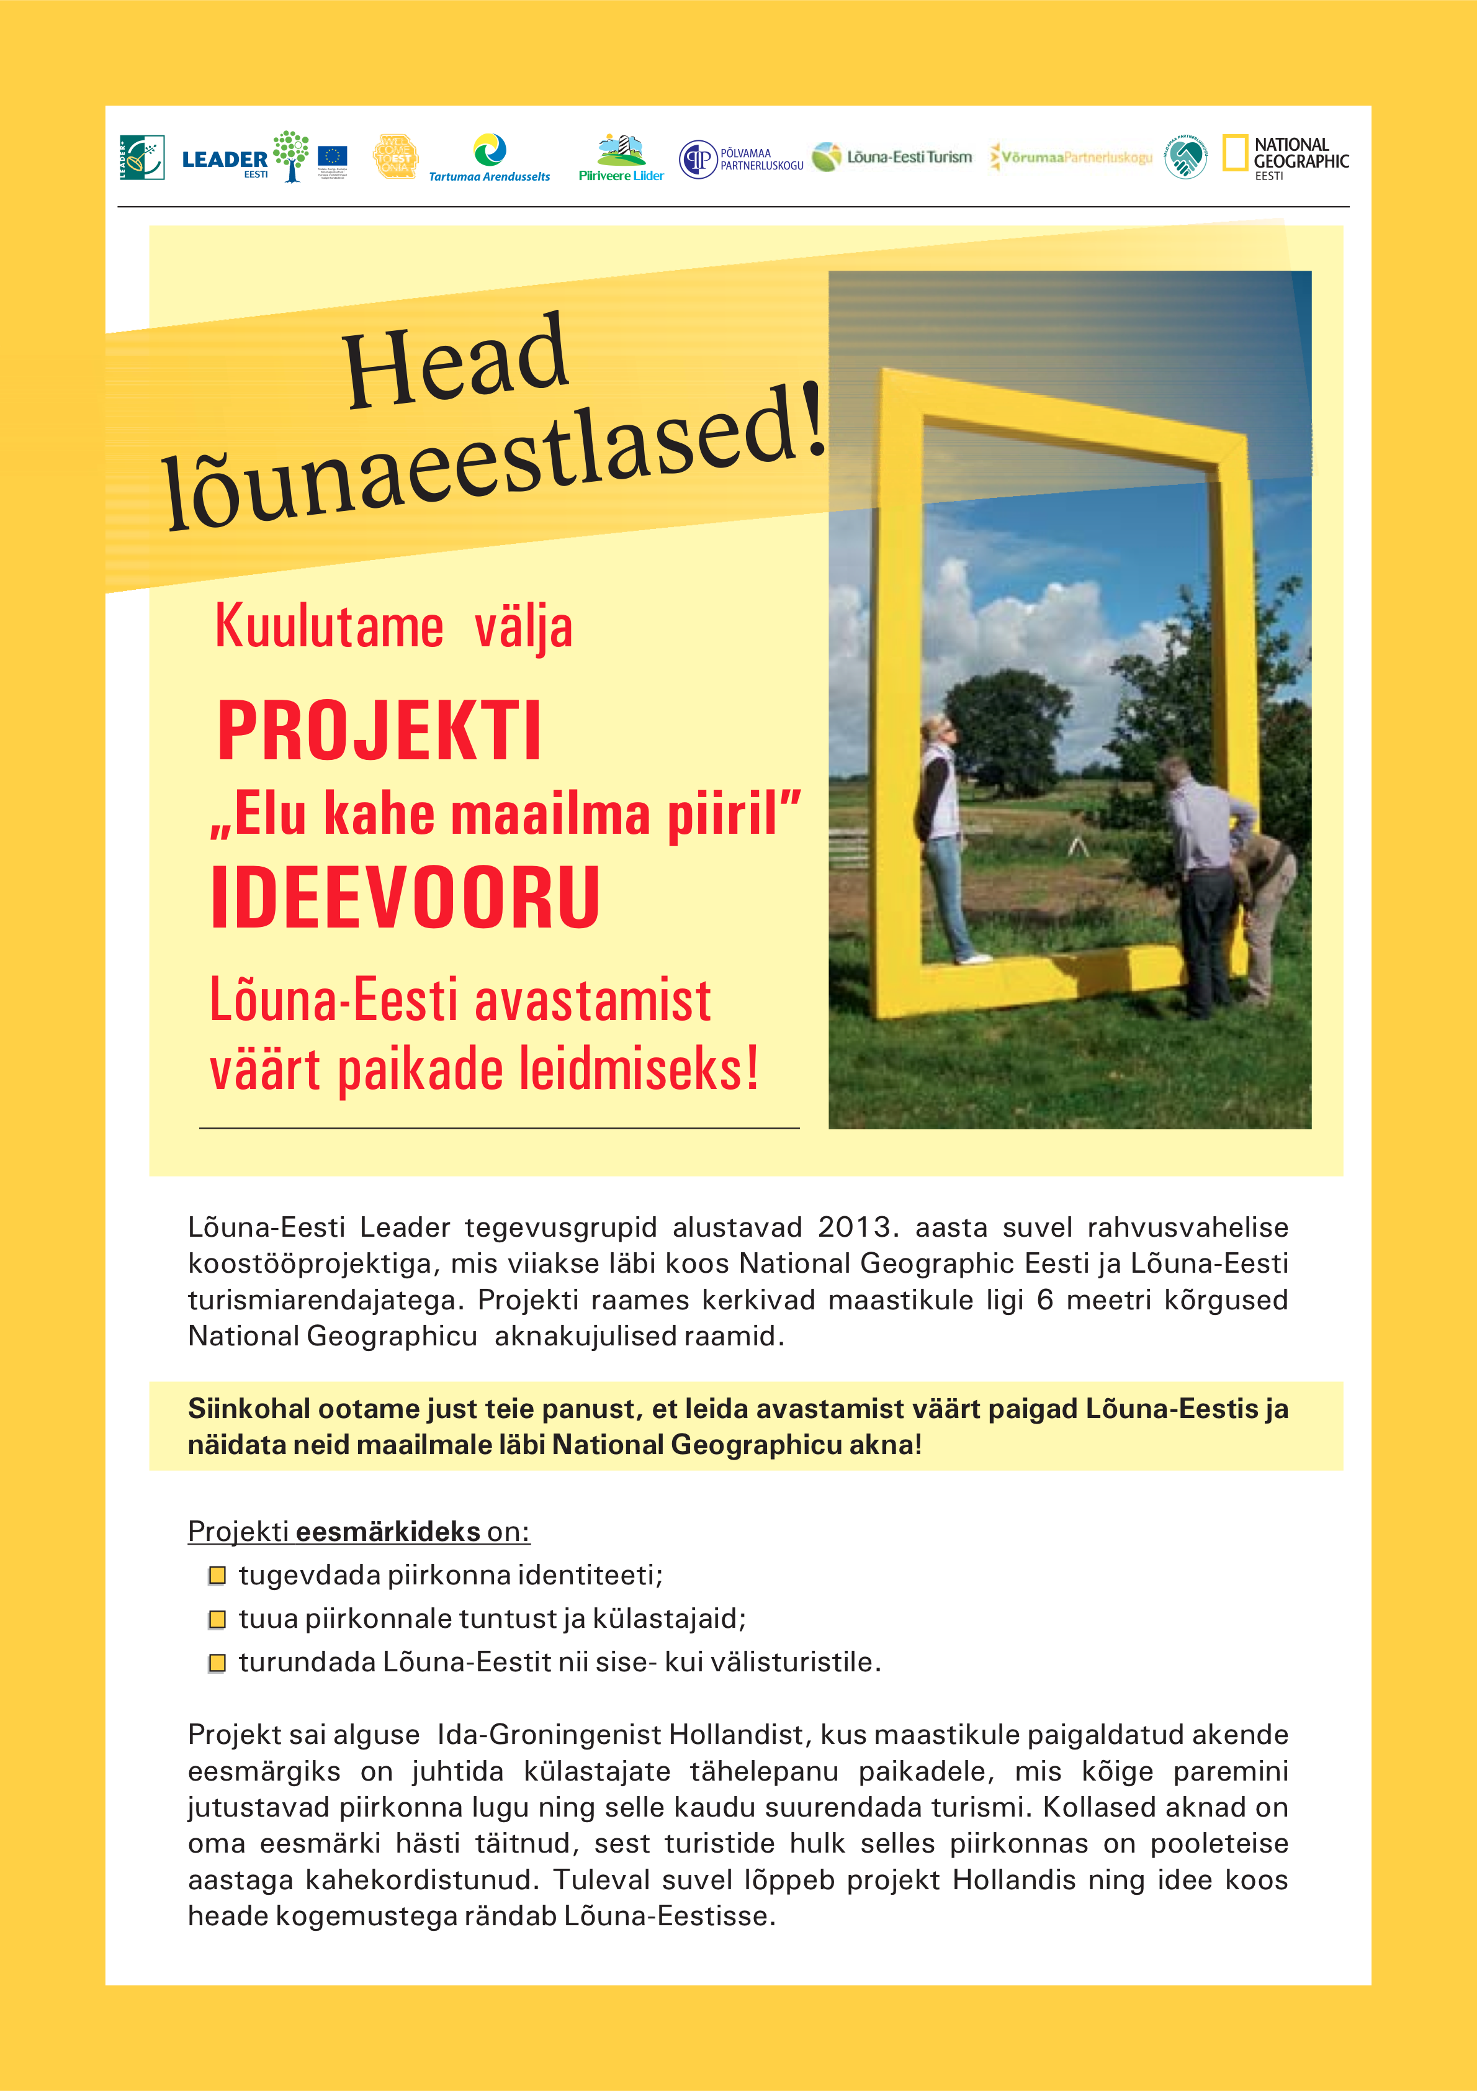
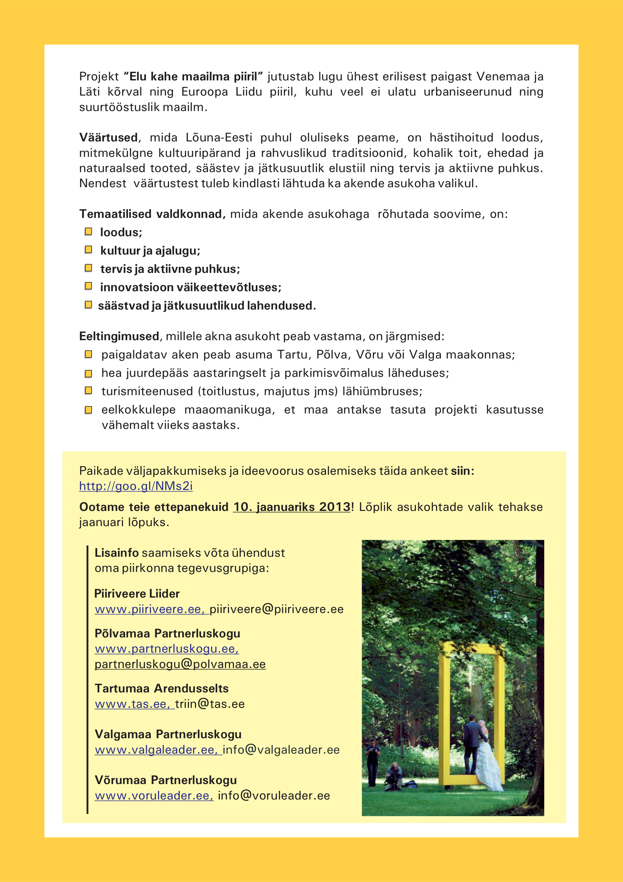

Slide 9
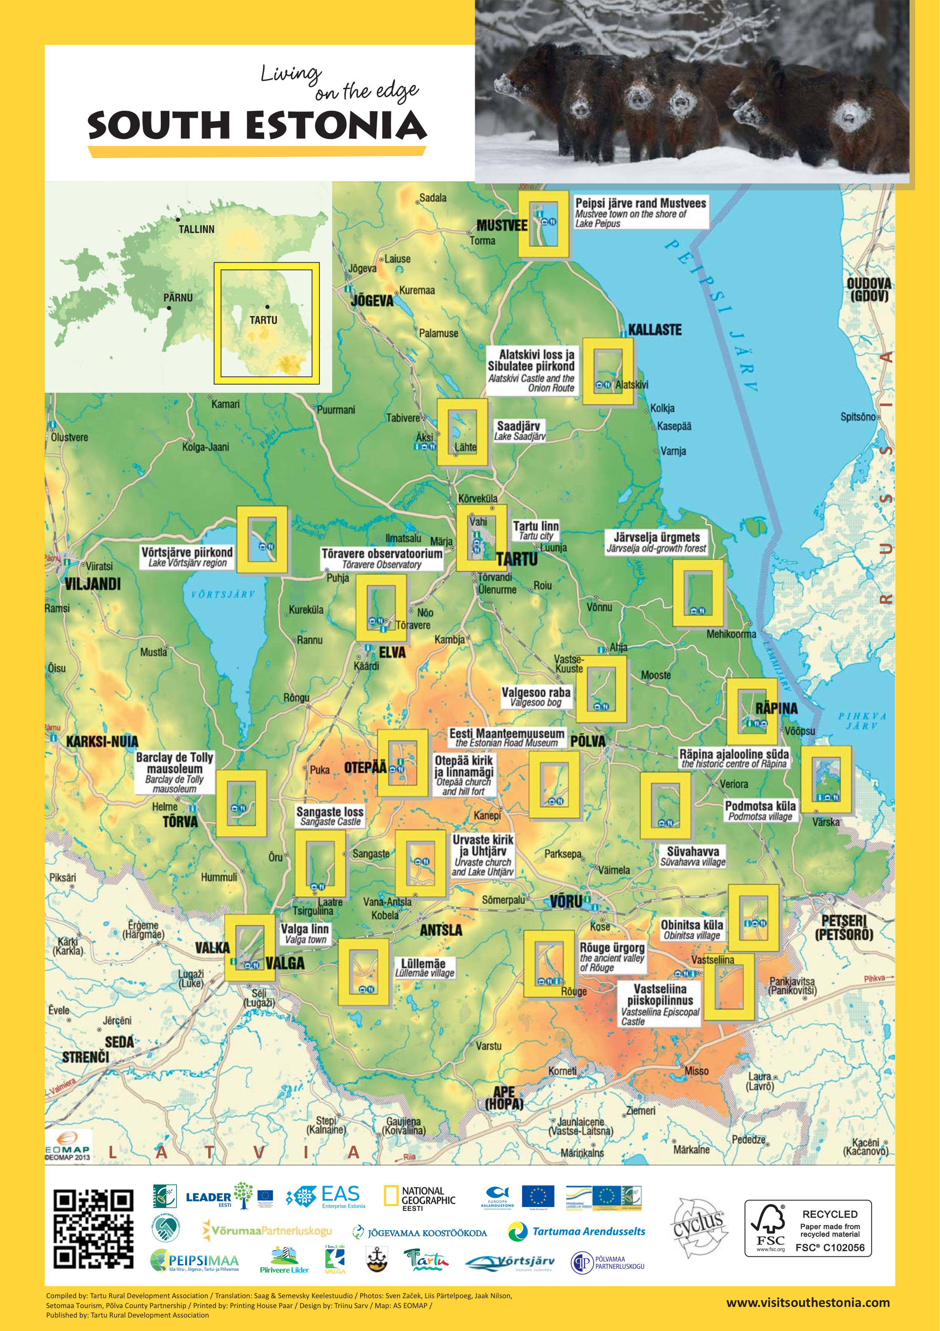
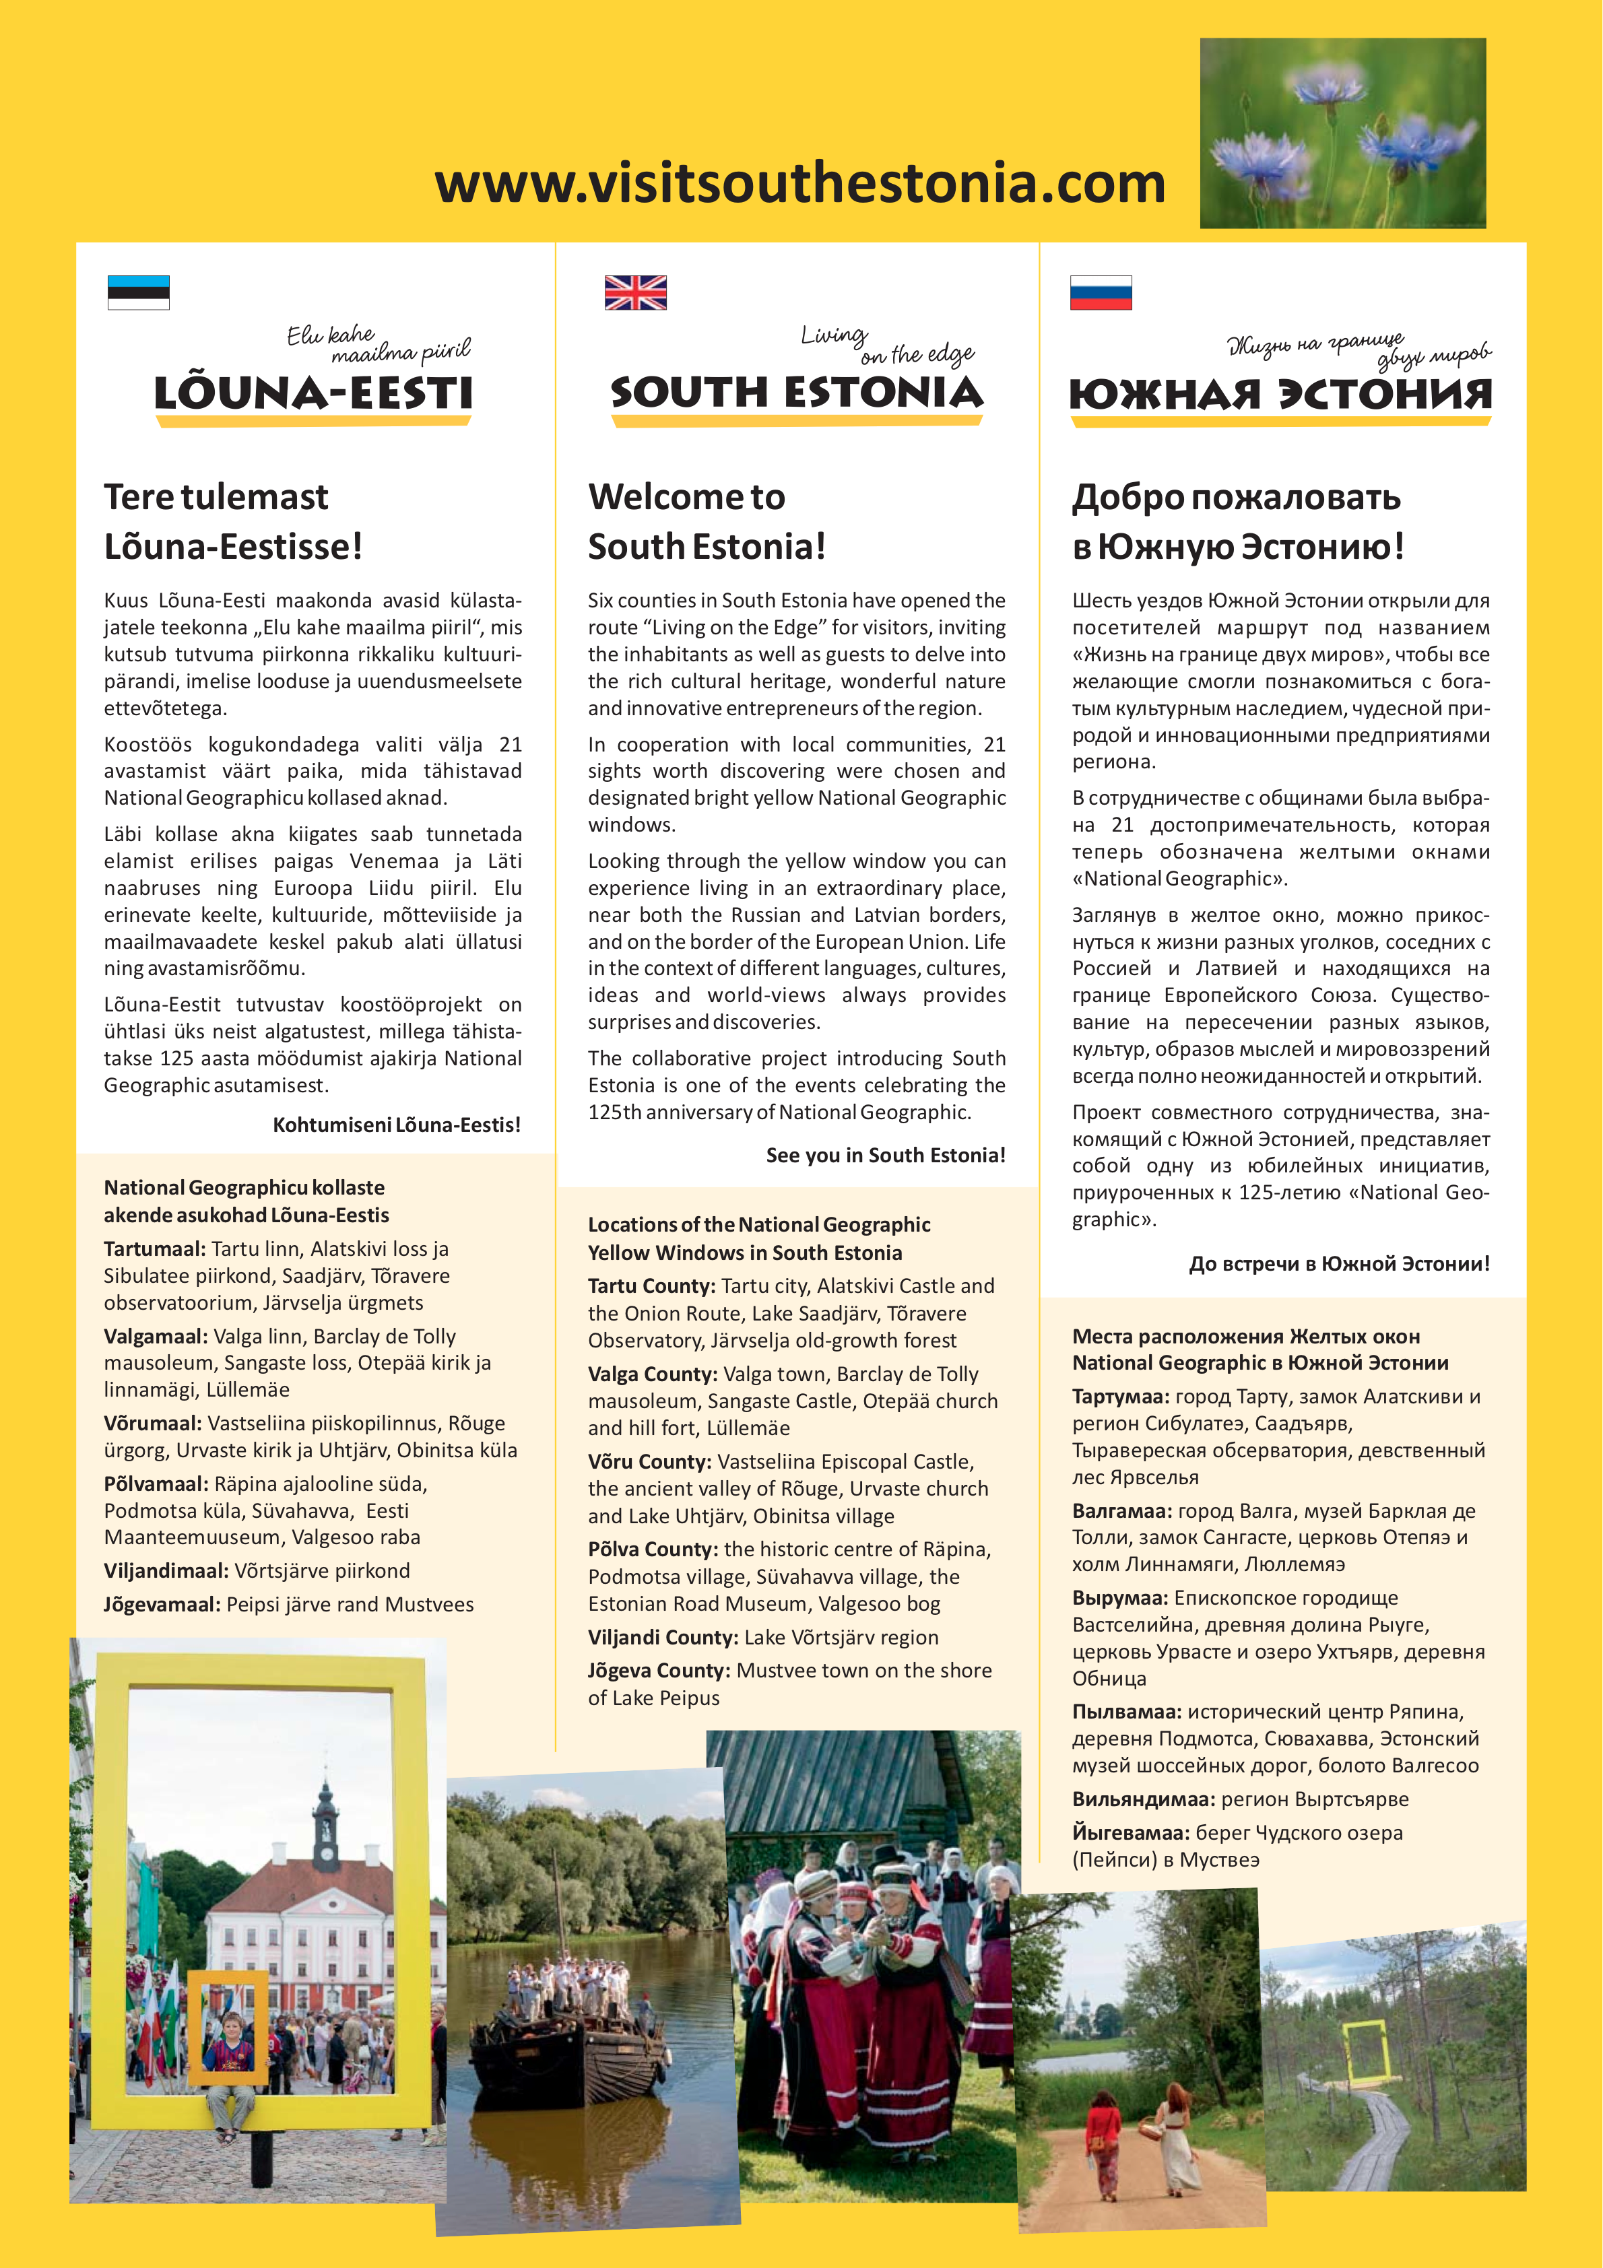
350 000 inhabitants
6 counties
30 partner organizations
500-600 entrepreneurs

Slide 10
Main project activities in 2013-2015
Creating yellow frames tourism route;
Training programs for entrepreneurs;
Media advertising: articles in the media, magazine National Geographic, television, social media;
Participation in fairs: travel fair, Balttour, Tourest;
Routes and study trip packages: culture and history, active holidays, innovation;
Photo exhibitions with famous photographs;
Marketing campaign activities: coupon book and offers website;
Organising competitions: photo and video competition, souvenir competition.
Notes:
We concentrated on tourism platforms during those 2 years. Tourism is a really good for joining people and organizations.

Slide 11
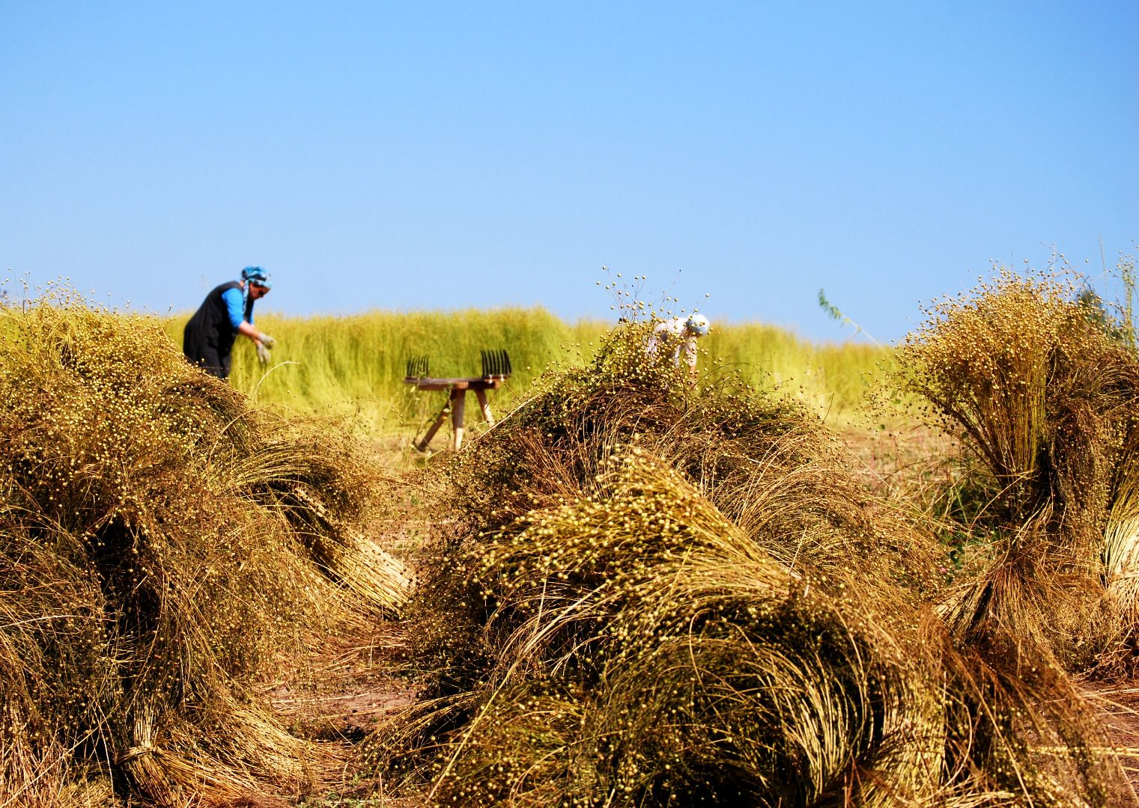
Notes:
Photo competition, 400 photos, 8 videos, 5000 people involved into assessment.

Slide 12
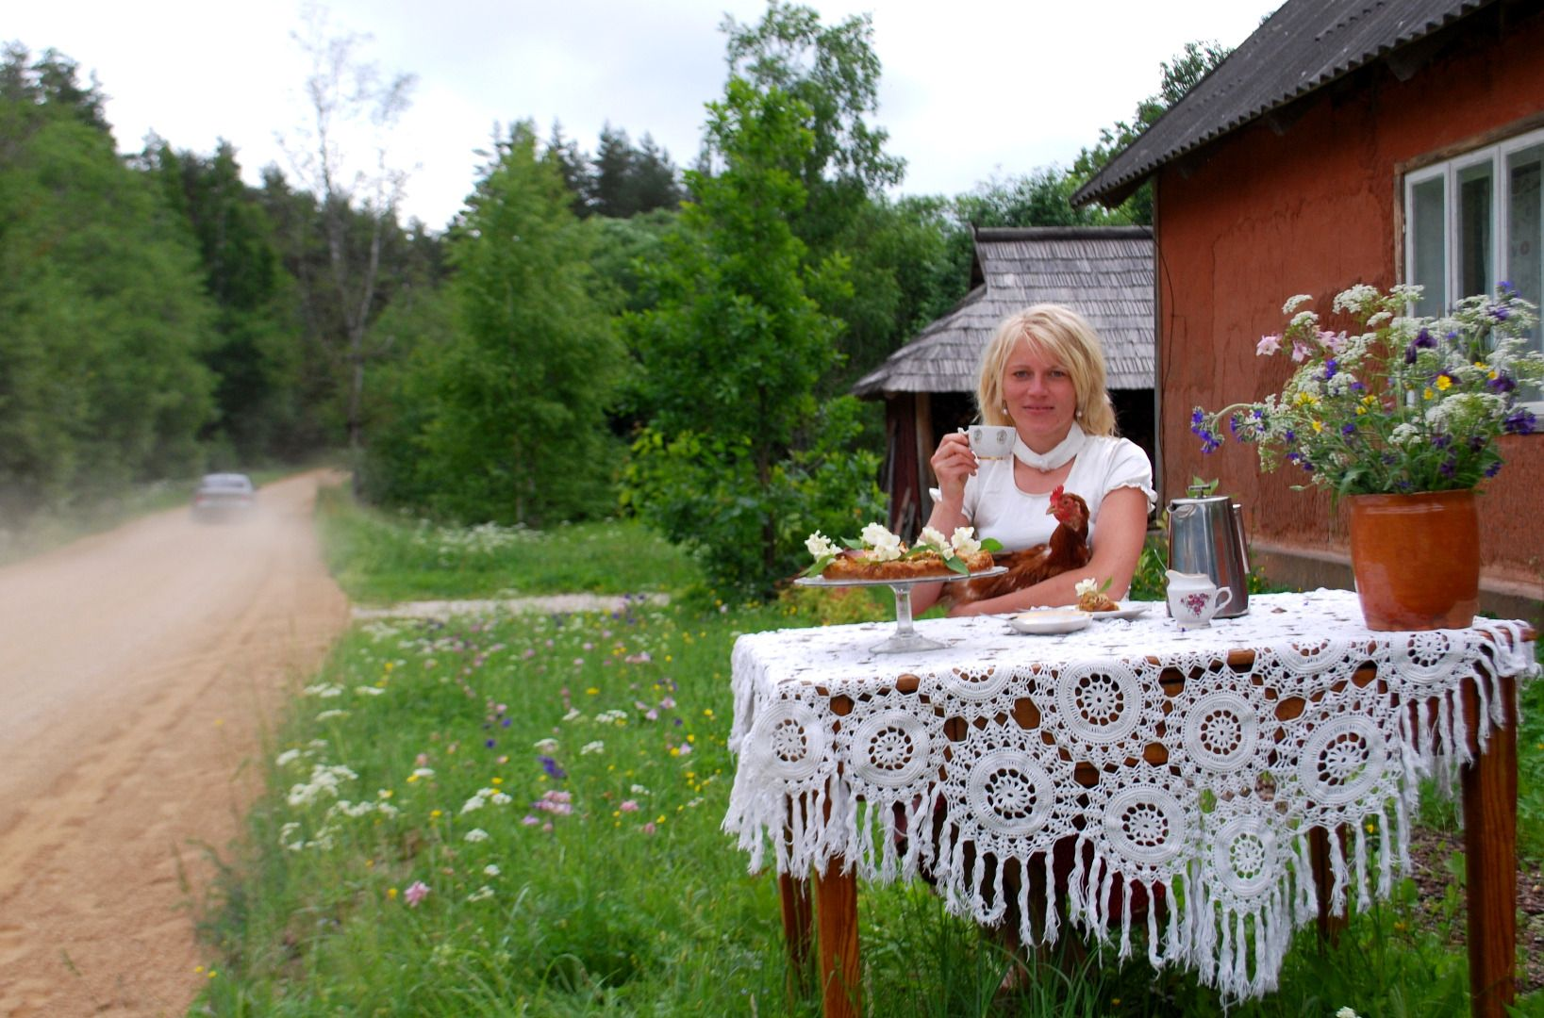

Slide 13
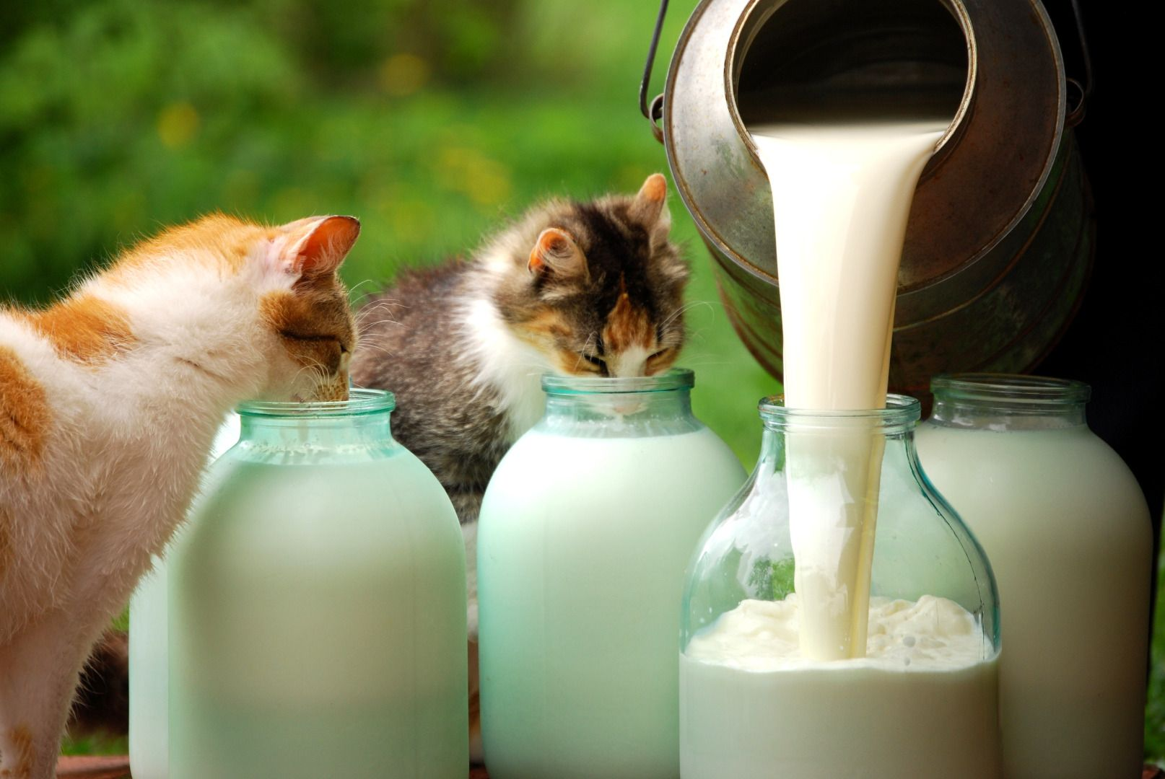

Slide 14
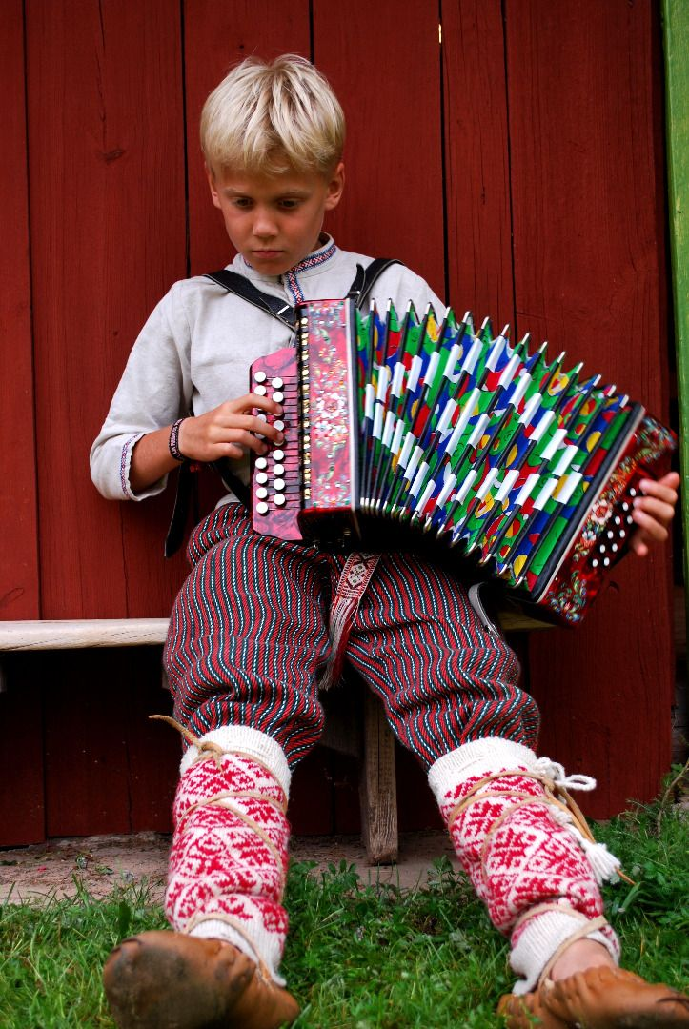

Slide 15
VIDEO
Notes:
Jooga in Tartu

Slide 16
Main activities since 2015 focus on innovation and sustainable development
Our role – to support the growth of innovation inside the region through networking and communication
Cooperation with competence centres (universities, science parks, etc.), Idea Lab (various parties involved);
Participation in research and development projects (sustainable technologies, IT applications, innovative methods etc);
Training and incubation programs for stakeholders, seminars and study tours;
Networking, awareness-raising and communication
Notes:
South Estonia is an innovative place for living, working and visiting

Slide 17
Why this project has been successful?
Identity – strengthening local communities and identity of the whole South Estonia region – 6 counties, 7 Leader areas;
New dimension of cooperation - across borders and sectors, networking between local communities and entrepreneurs. 500-600 entrepreneurs involved. Additionally to tourism entrepreneurs we involved industries and scientific institutions, IT;
Rural and urban co-operation. 8 towns involved outside Leader area;

Slide 18
Why this project has been successful?
Innovative structure of management – 30 organizations involved as partners;
Empowering the innovation of the region - innovation route, involvement of universities and scientific institutions, creative industries and IT technology;
Multi financing model - EAFRD and Fisheries Fund, Estonian Enterprise, public and private sector;
Number of visitors - growth of internal toursim 12%, website www.visitsouthestonia.com visits increased 3 times.

Slide 19
Challenges
Creating common understanding again and again. Involvement and openness;
Involvement of entrepreneurs, difficulties to explain direct benefits at the beginning;
Management of multi financing budget among project partners;
Technical support related to budget and eligible costs. Project model was very new also for MA/PA;
Public procurement requirement cleared up at the end of the project.

Slide 20
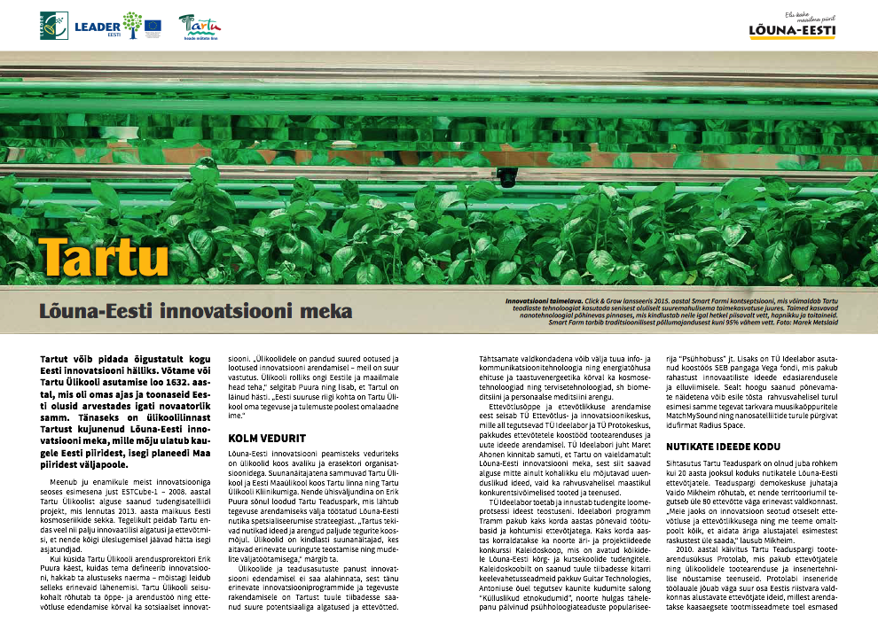
Notes:
This year we started innovation stories in National Geographic magazine.

Slide 21
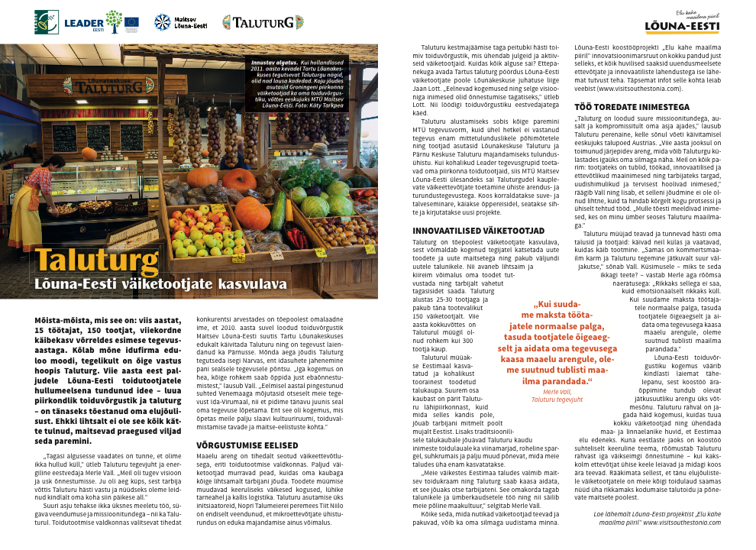

Slide 22
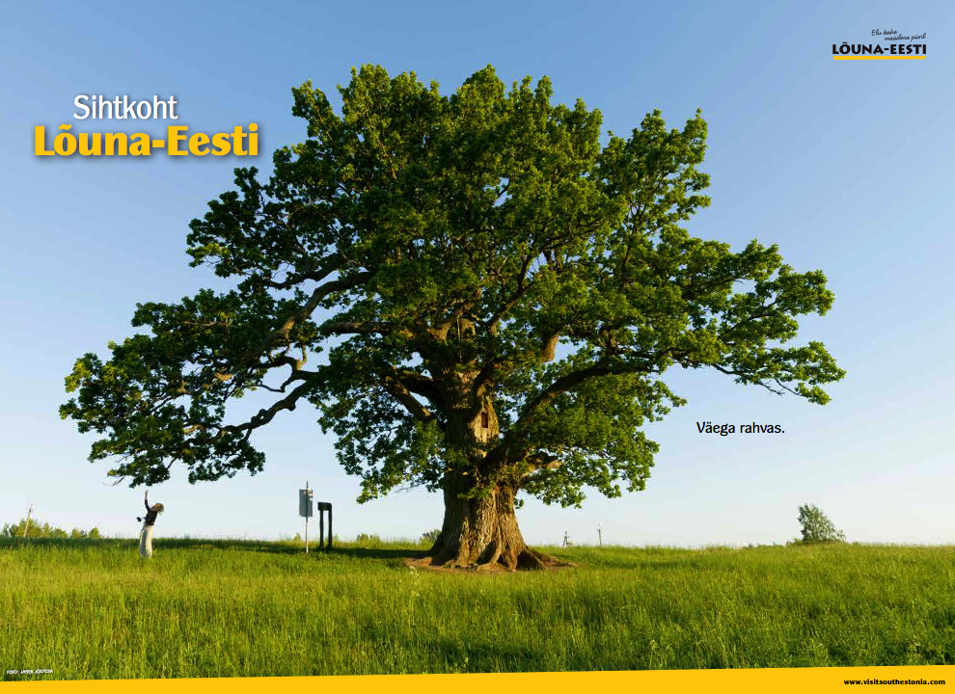

Slide 23
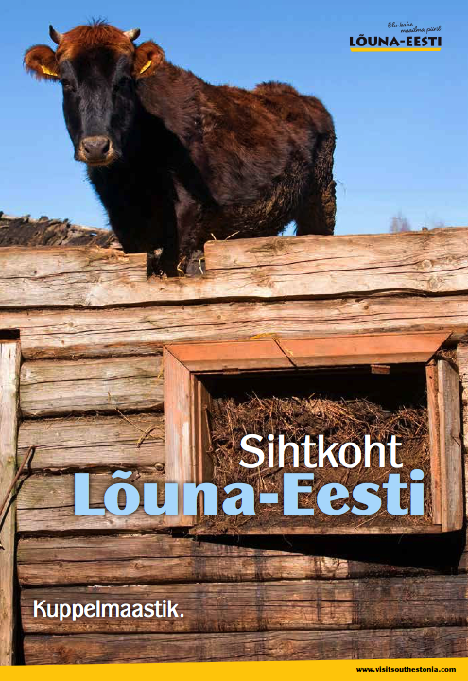

Slide 24
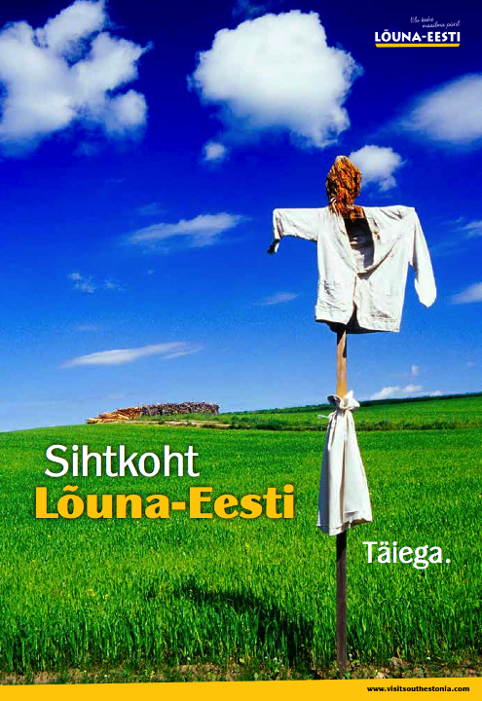

Slide 25
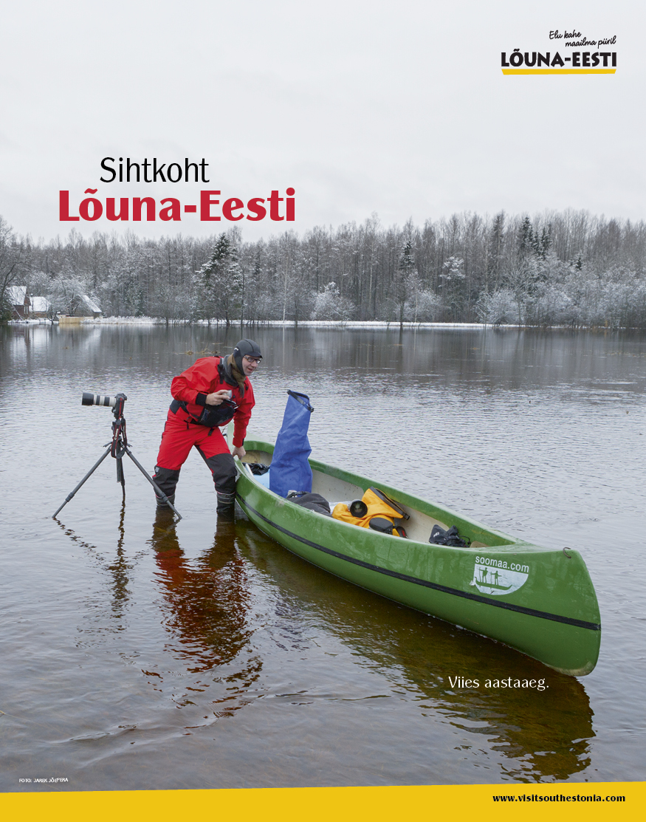

Slide 26
Notes:
Kaart

Slide 27
Notes:
Kaart

Slide 28
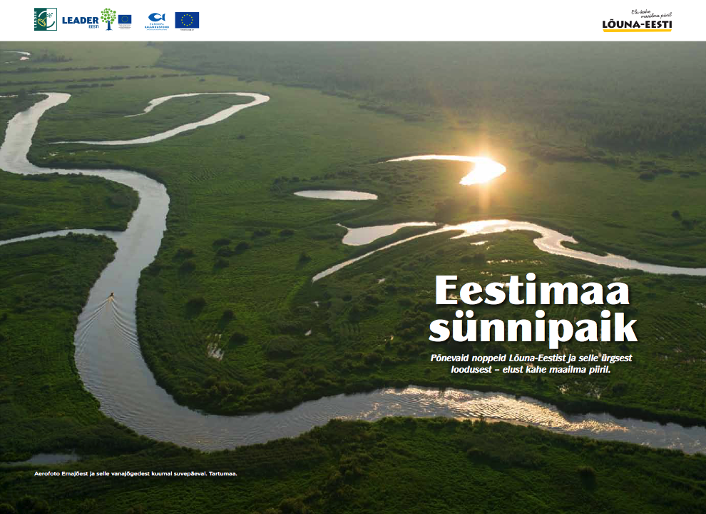
Notes:
Lugu sellest, kuidas munamägi sündis. Siis kui kõik oli veel suure vee all, otsustas üks linnuke et tema soovib oma pesa punuda, et pojad saaksid välja kooruda just Lõuna-Eestisse. Ja nii ahkkas ta suure veekogu põhajst setet kokku kandma ühte kohta, kuini veest ulatus välja täpselt selline mügarik, kuhu sai teha pesa. Ja nii sündiski Munamägi ja koos sellega ka Lõuna-Eesti.

Slide 29
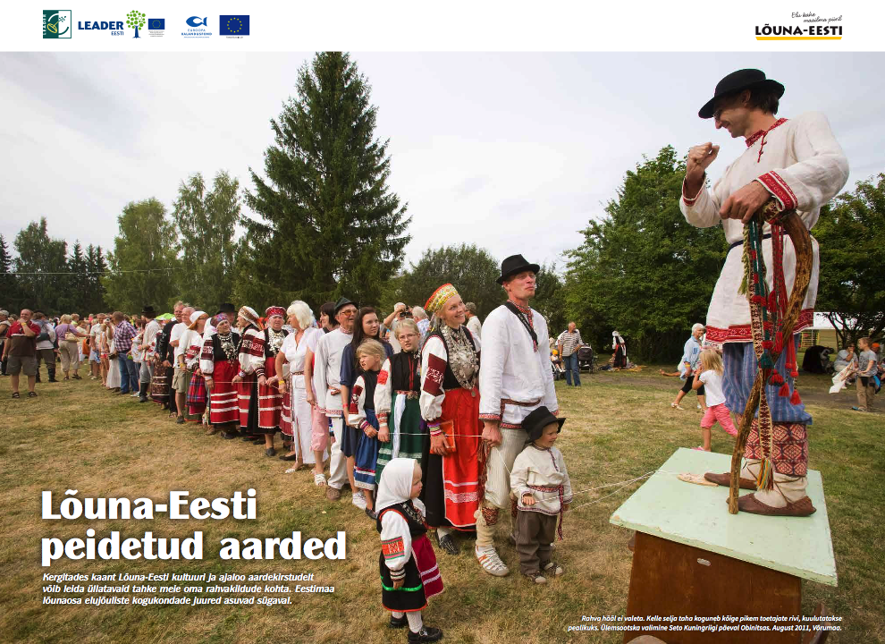
Notes:
Karl XII kullavankri lugu Põhjasõja päevilt. 300 aastat on möödnud, aga rahvas ikka mäletab.

Slide 30
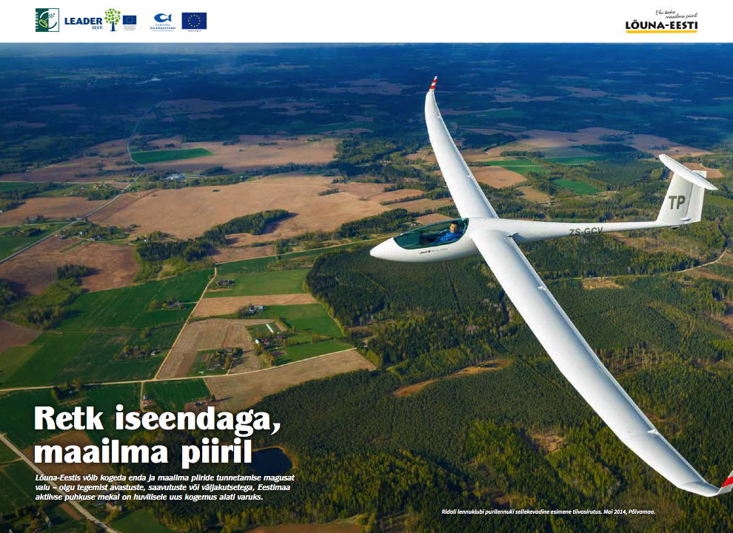

Slide 31
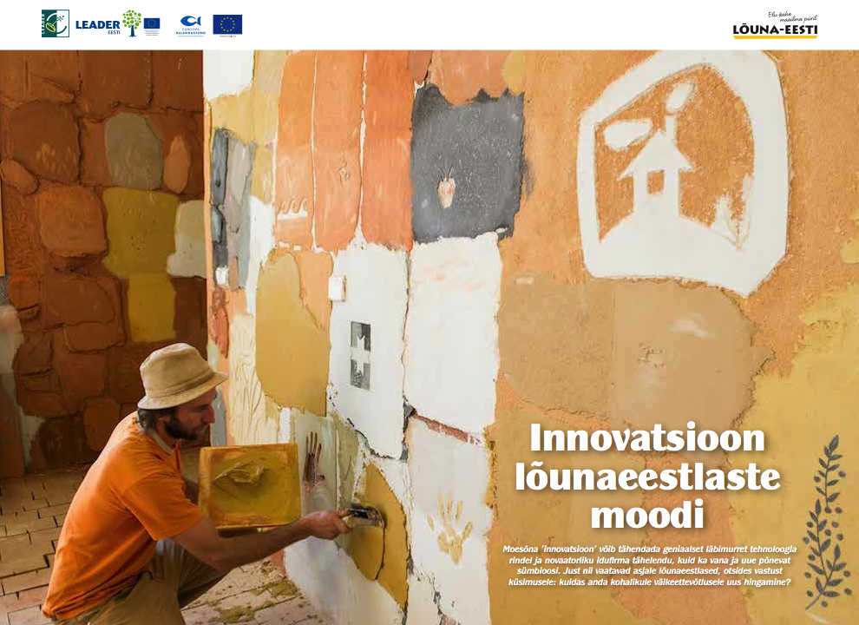

Slide 32
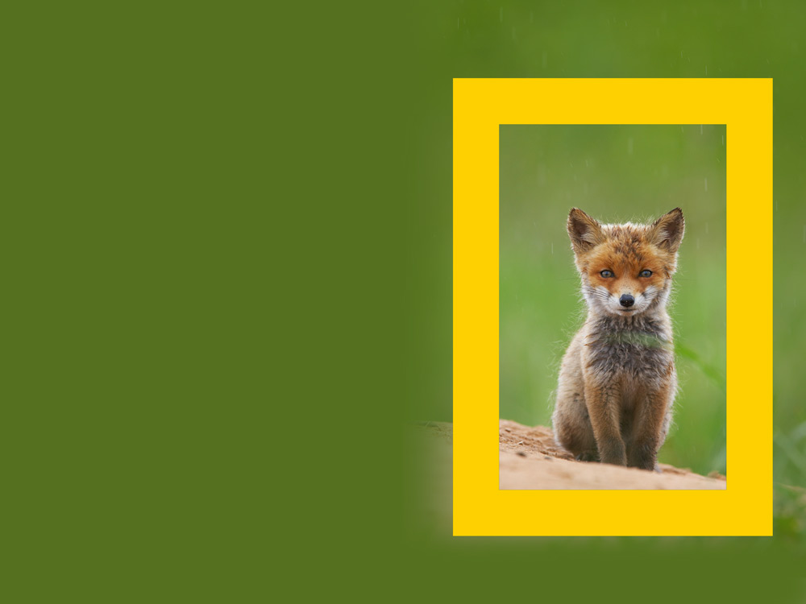

Slide 33
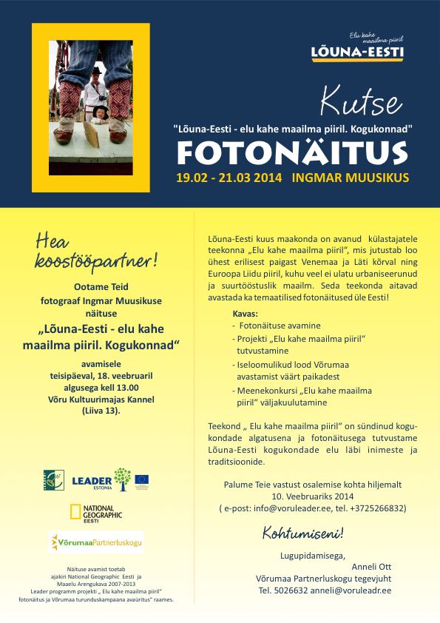

Slide 34
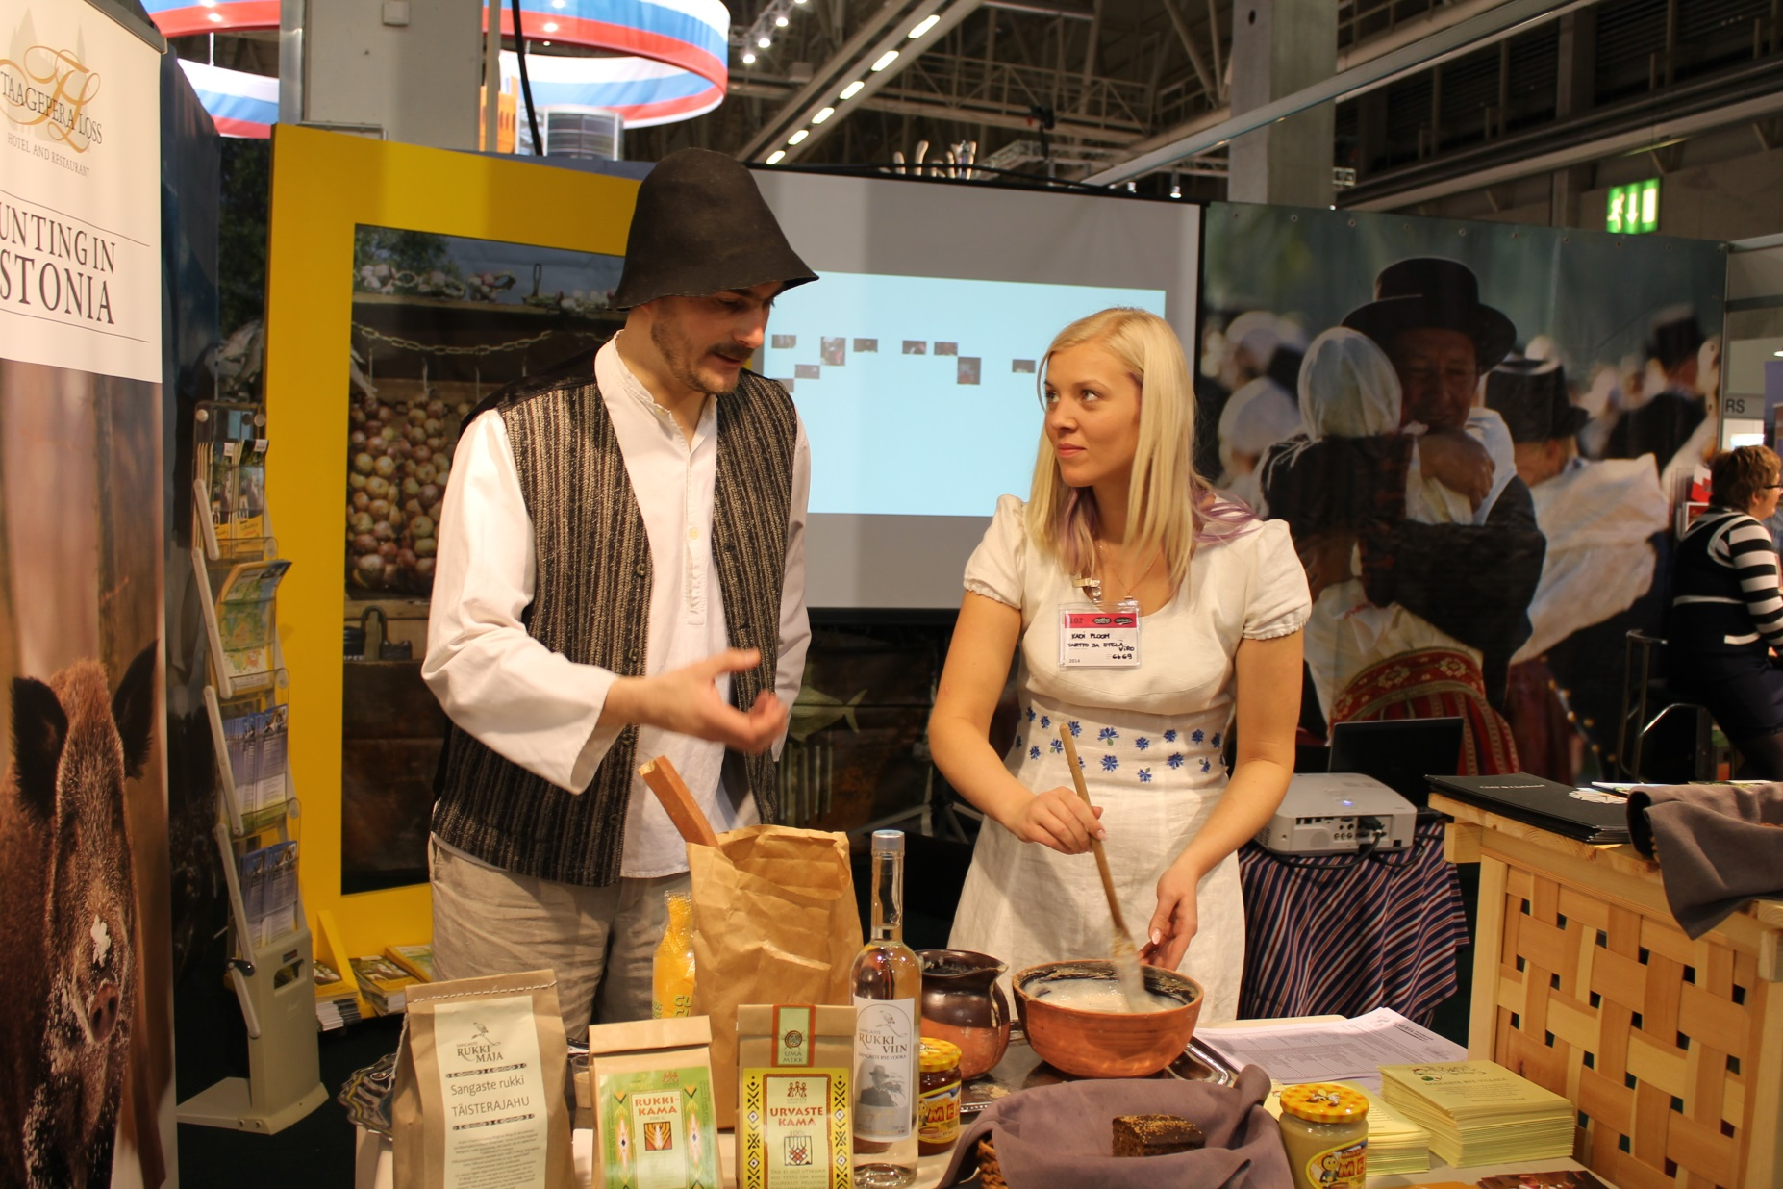
Turismimess MATKA Helsingis

Slide 35
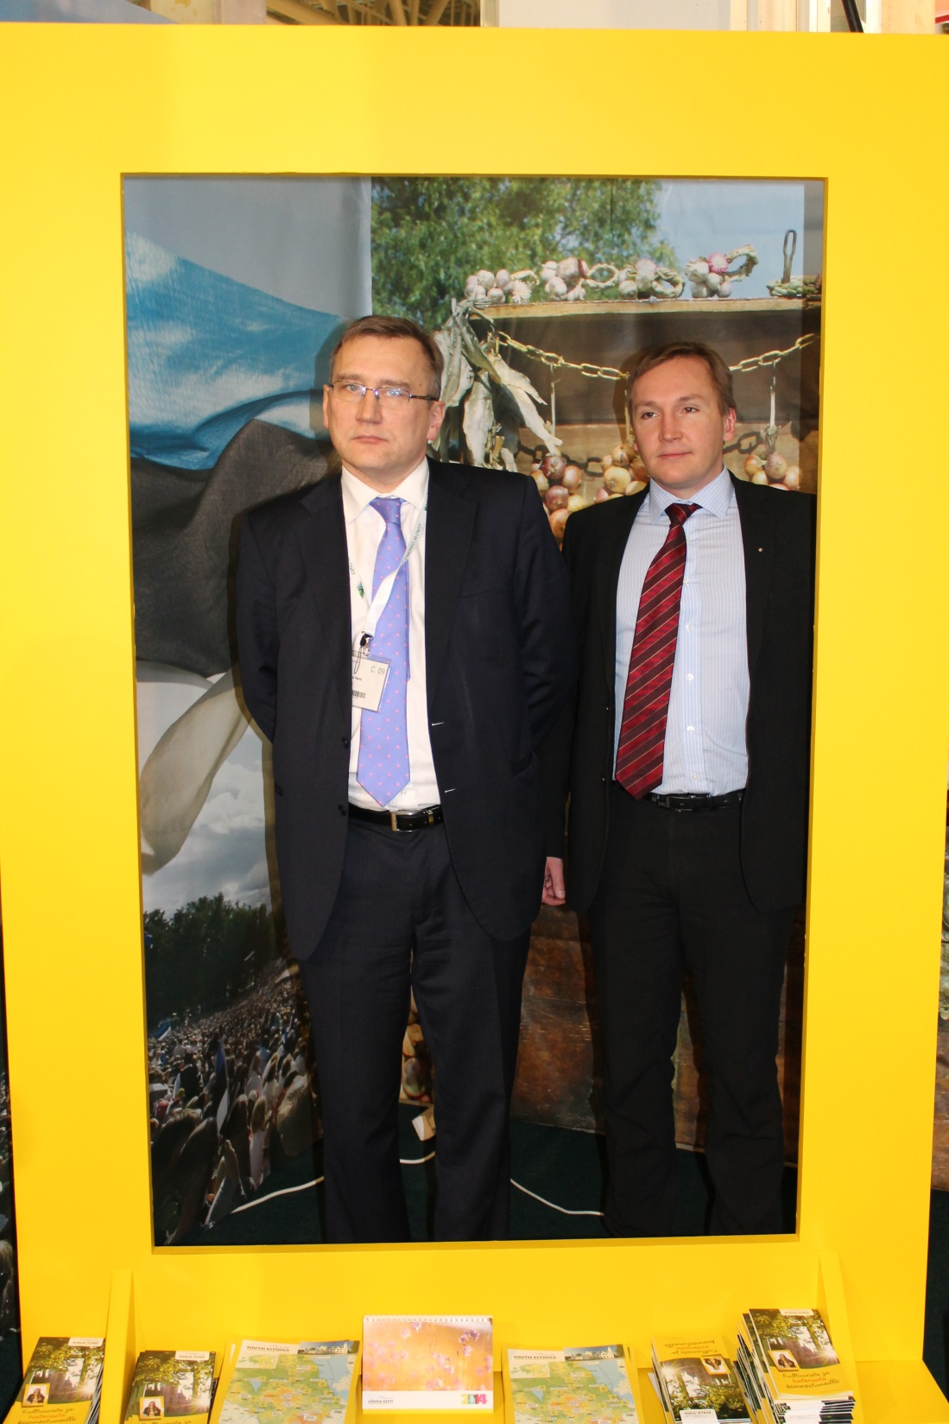
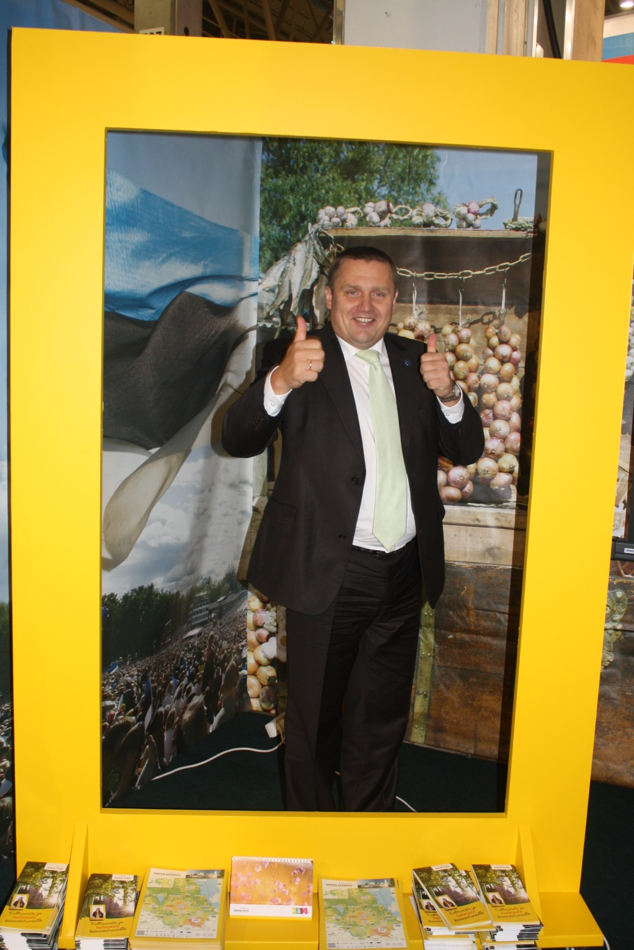

Slide 36
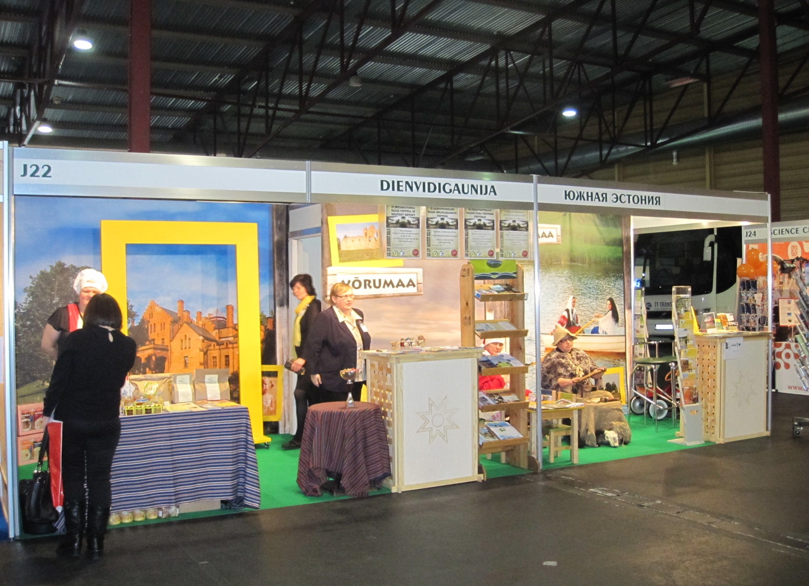

Slide 37




Kultuuri- ja ajaloomarsruut

Slide 38
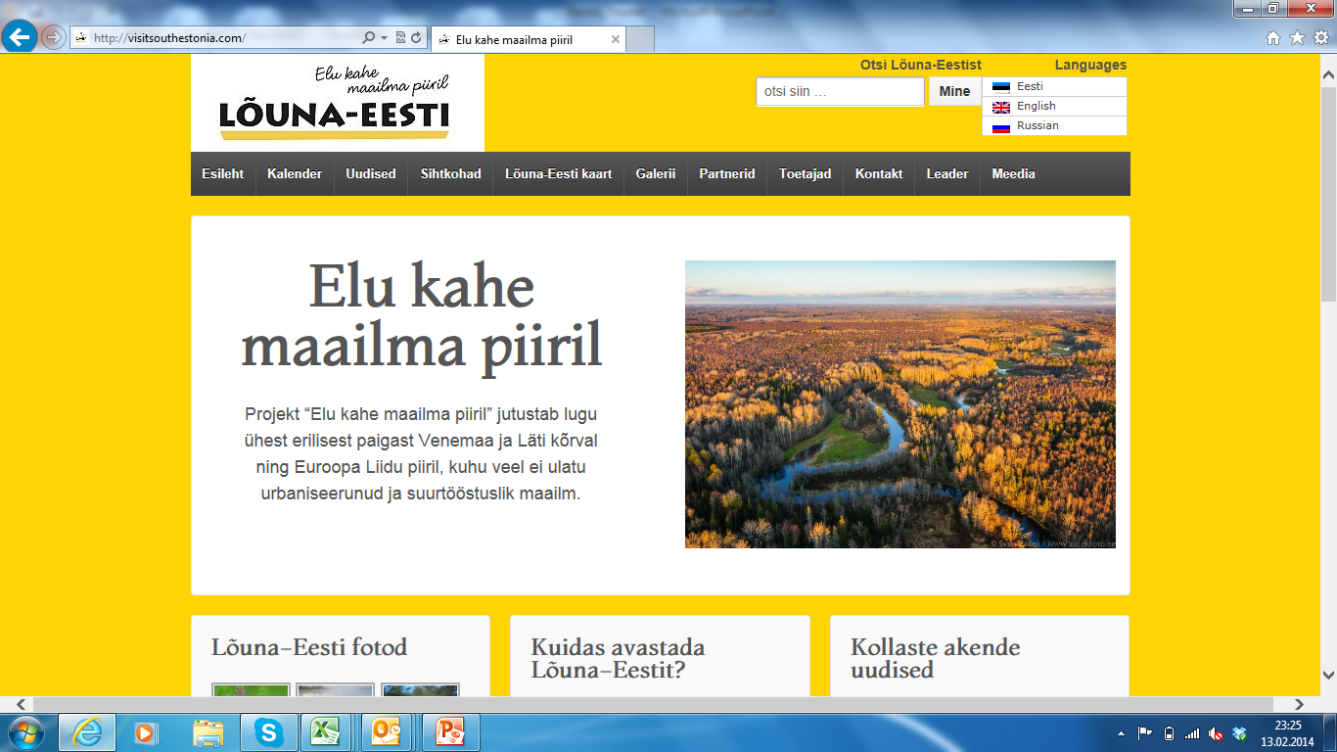
www.visitsouthestonia.com

Slide 39
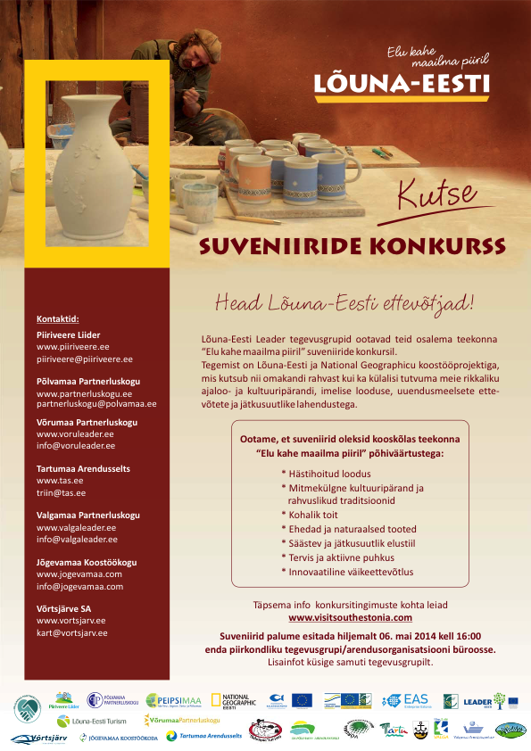

Slide 40
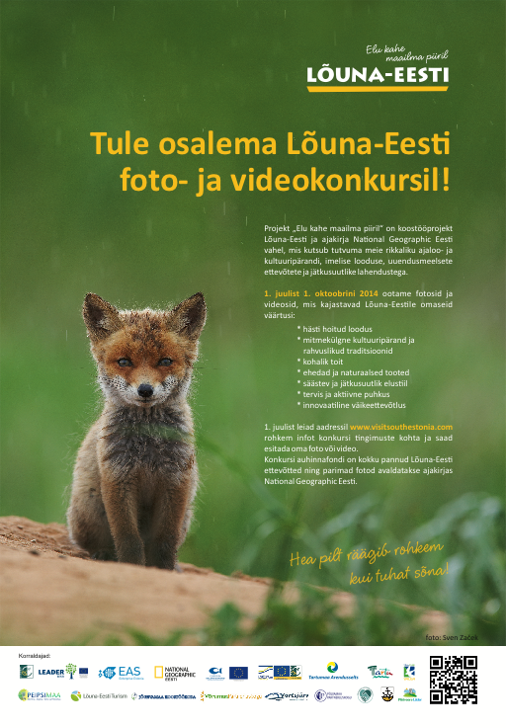

Slide 41


Slide 42
