Slide 1

LEADER transnational cooperation project and 17th Summer Academy joint seminar "Creating innovation and smart solutions for sustainable local development”
Future scenarios of local development
Mihkel Laan, Cumulus Consulting Ltd
Tartu, Estonia
20th September 2018
Notes:
Good morning, it is your 4th day so you must be exited to hear a presentation full on theories about future scenarious
My background: 15 year as a regional and local development consultant; human geographer
2013 – mid-term evaluation of leader strategies in Estonia; since that time I’m a big fan on Leader movement
In simple terms – the money put in and the impact that is has is among the best

Slide 2
My story for today
General trends
Challenges in Estonia
Can LEADER save the world?

Slide 3
Kondratieff waves of innovation
Notes:
The question – how effective are the local level players in implementing those trends?

Slide 4
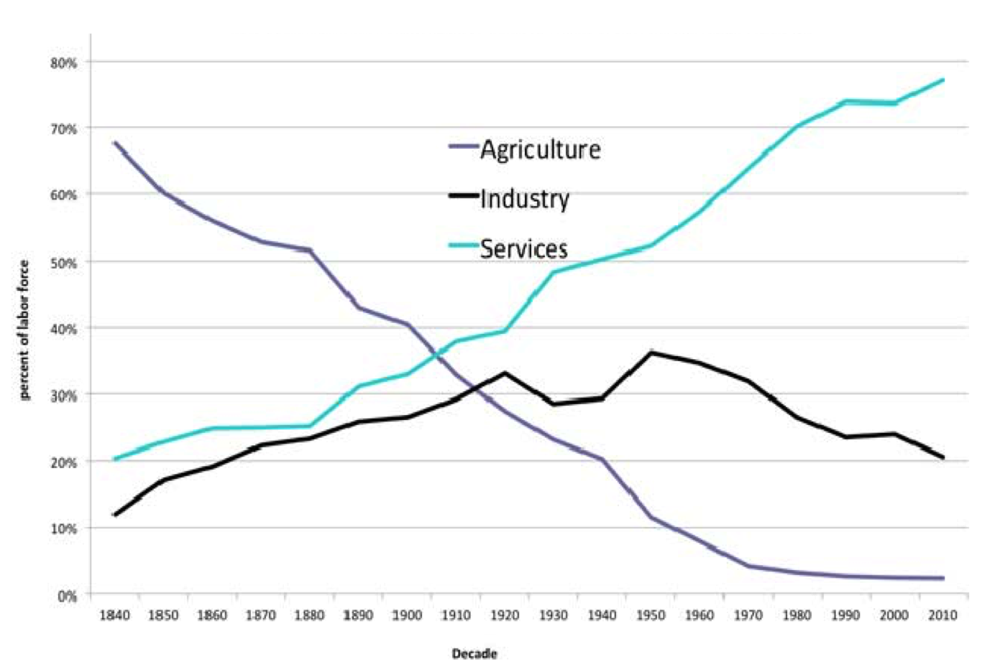
Employment by sector: USA
Notes:
THE QUESTION: WHAT IS RURAL LIFE?
- People who live in rural areas are not farmers!
- Most probably they don’t work in industry as well!
- They deliver some kind of services

Slide 5
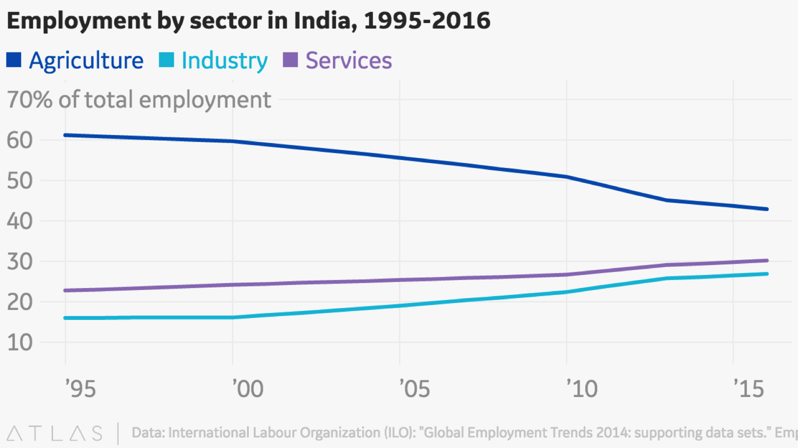
Employment by sector: India

Slide 6
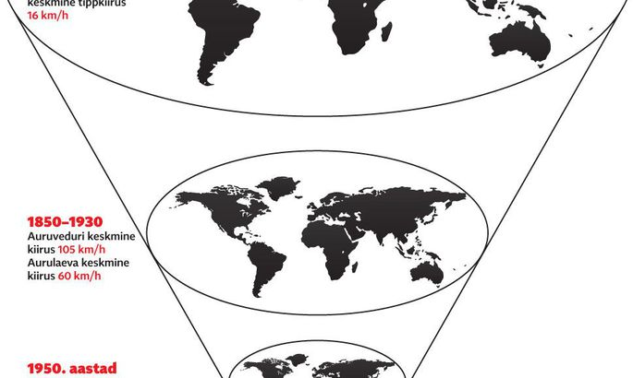
Growing interaction and integration
2018
2035
Source: Tiit Tammaru
Notes:
CHALLENGE: How to hold and protect our traditions and at the same time implement the most innovative business models?
SETOMAA NÄIDE!

Slide 7

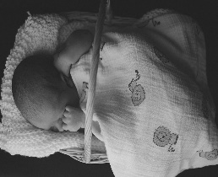

Generation Z
2018
2035
Source: Tiit Tammaru
Notes:
HARJUMAA STSENAARIUMI NÄIDE!
Technology and social media! FB is like CD player, it’s not used anymore!

Slide 8
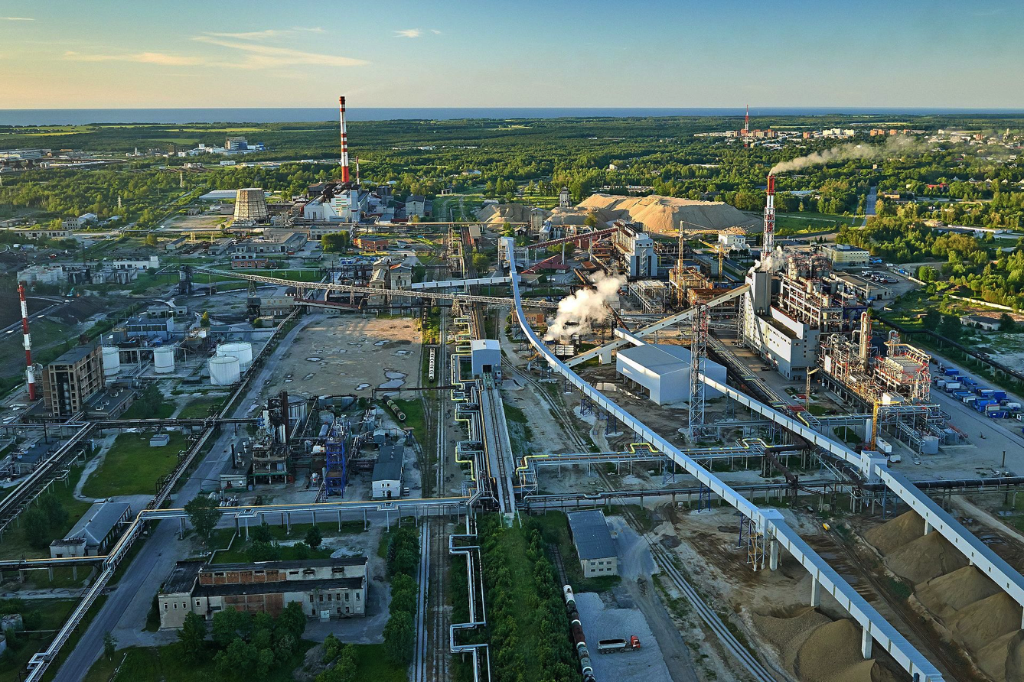
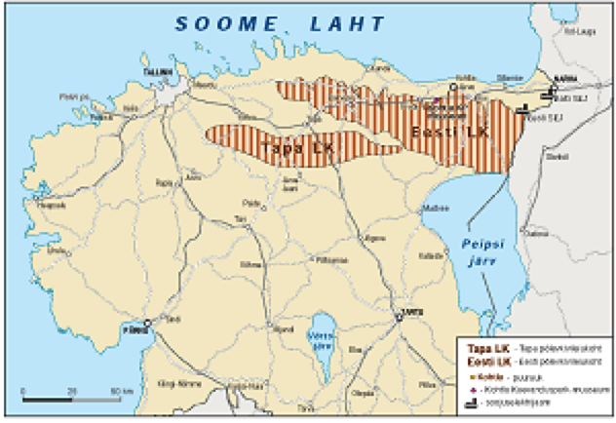
3rd and 4th wave: oil shale mining and industry in 21st century?
Notes:
To what extent investing in 3rd and 4th wave is OK?

Slide 9
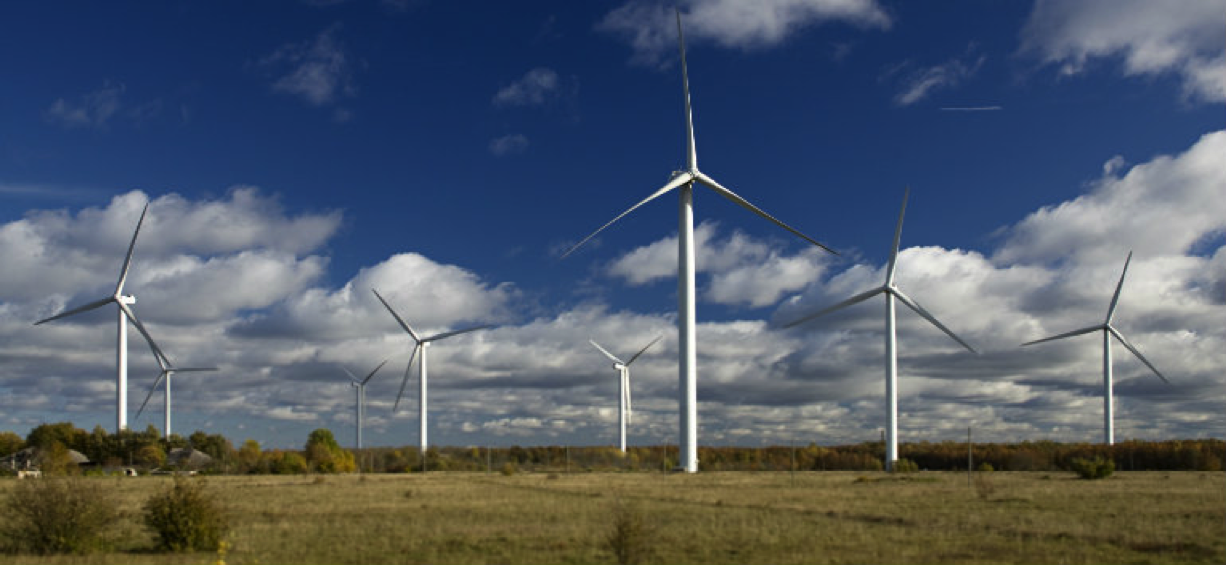
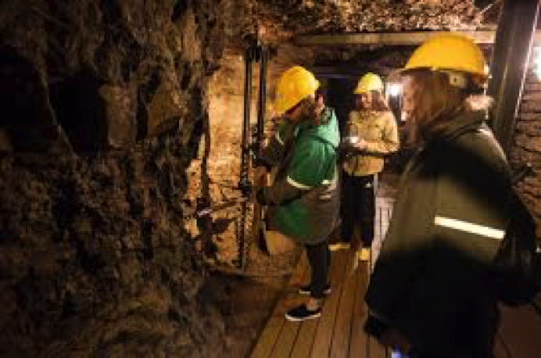
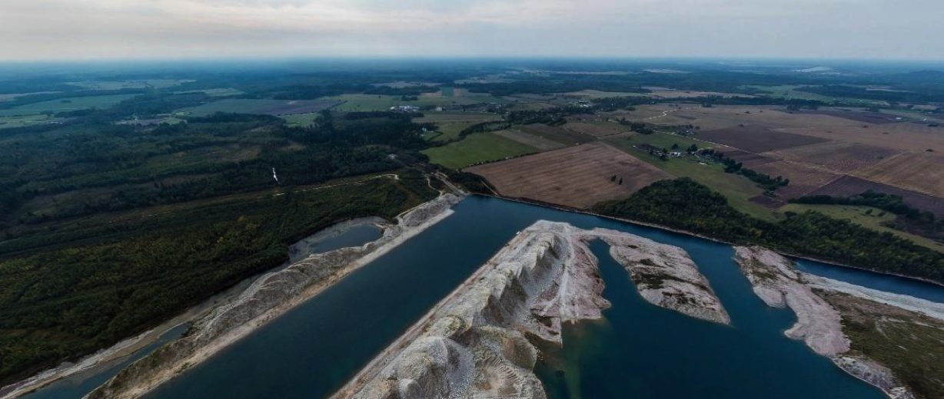
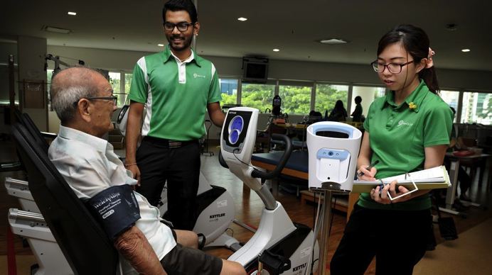
Or renewable energy, health care and tourism?
Notes:
Opencast mine – Aidu
Undergroung mine - Kohtla-Nõmme

Slide 10
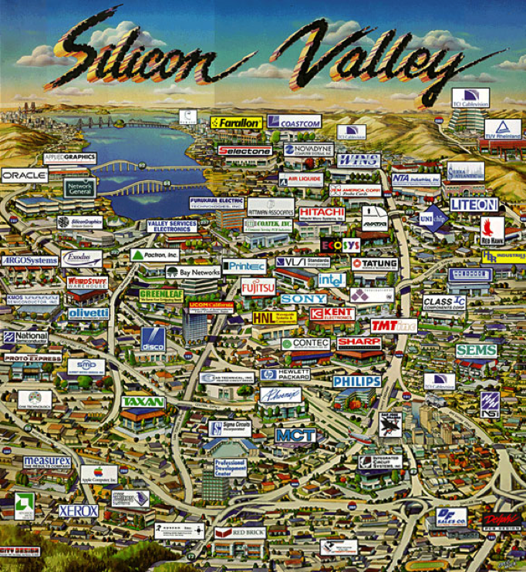
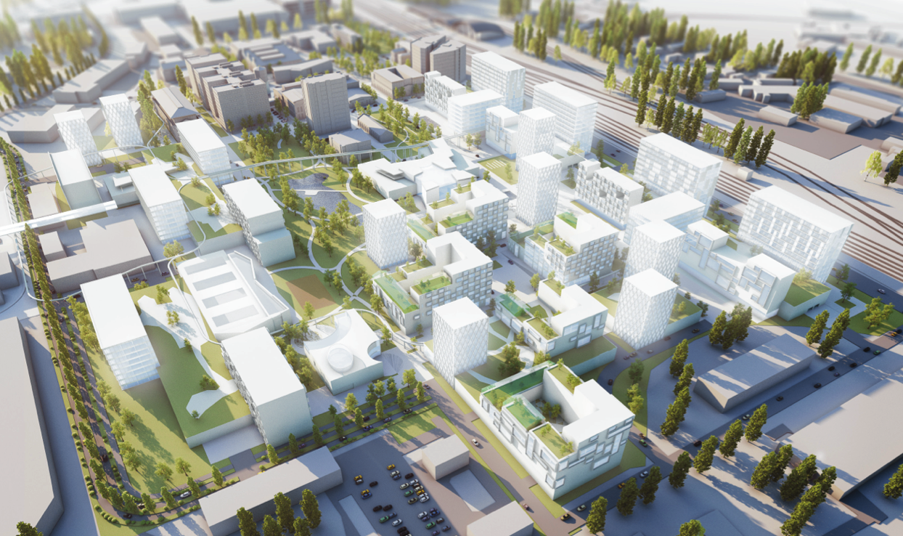
5th wave in California and Ülemiste City (Tallinn)
Notes:
People went to live in places were the jobs were
Shift – jobs go there where the great communities are
The question is - how can we build an environment for

Slide 11
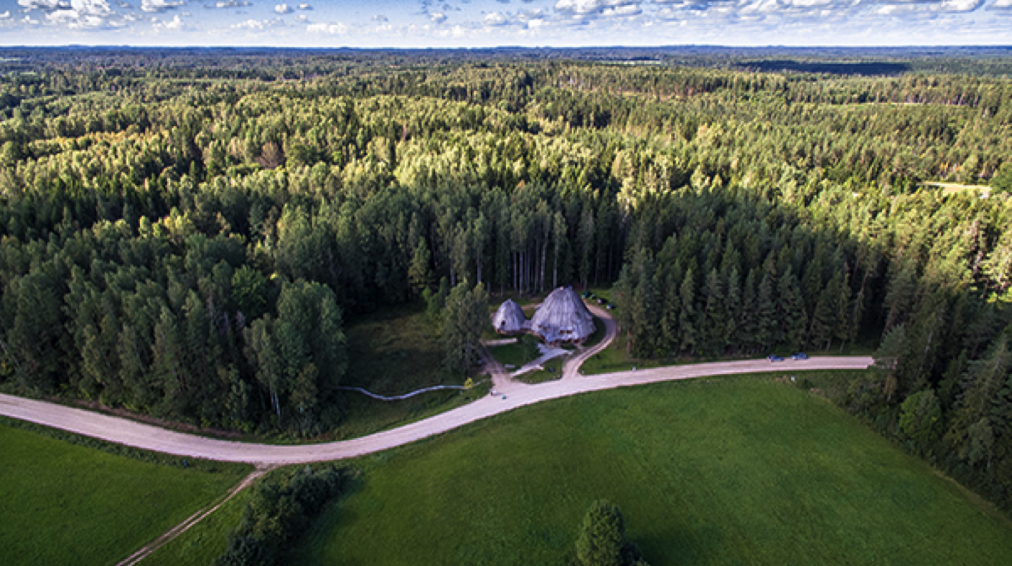
6th wave?
Source: Garri Raagmaa
Notes:
Fresh air; water; forests, musruums etc
Also internet ☺
Business is here?s

Slide 12
Local challenges I: demographics
Ageing – the rise of elderly from 18% in 2015 to 28% in 2050?
In rural areas -20% in next 10 years?
Who is „paying the bills“ - the pressure towards more efficient public sector?
Notes:
population pyramid of one local municipality

Slide 13
Local challenges II: (empowered) community instead of public sector?
Local governments (LG) in Estonia | Before local government reform (Jan 2017) | After local government reform (Jan 2018)
Number of LGs | 213 | 79
Less than 5000 inhabitants | 169 | 17
5000-11 000 inhabitants | 28 | 34
More than 11 000 inhabitants | 16 | 28
Median inhabitants | 1887 | 7739
Territory median (km²) | 180 | 512
Notes:
Mooste näide – vallavanem viib koju külajoodiku

Slide 14

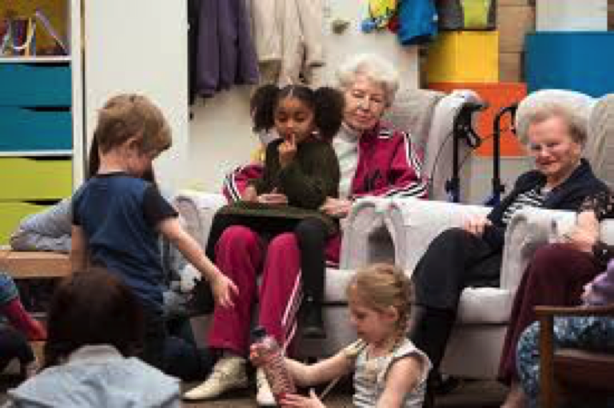
Local challenges III: cross-sector collaboration
Public-private-3rd sector + education, social services, leisure etc
Common strategy and goals?

Slide 15
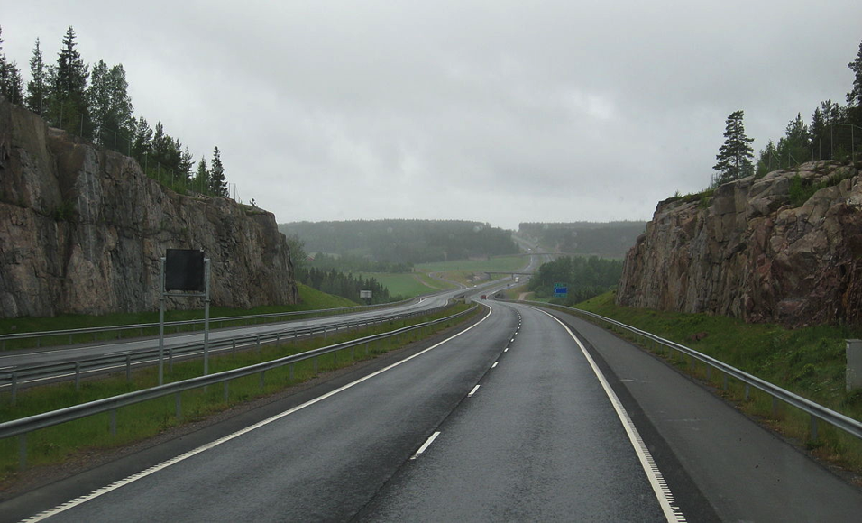
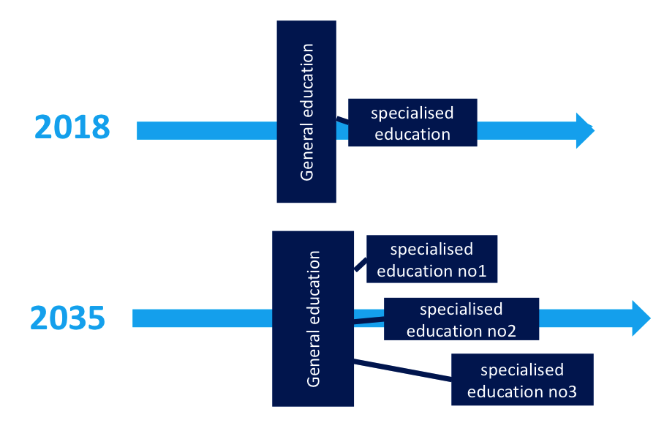
Local challenges IV: investing in infrastructure or human infrastructure?
Source: Tiit Tammaru
Notes:
RETRAING!

Slide 16
Why LEADER saves the world?
It focuses on integration and innovation, both are key words in 2035
It deals with rural areas, where the (demographic) challenges are the biggest
It helps to empower community and “can do will do” attitude
It focuses on cross-sector collaboration
It invests in people and networks not only infrastructure

Slide 17
Thank you!
Mihkel Laan
Cumulus Consulting Ltd
Consultant, Member of the Board
mihkel.laan@cumulus.ee
+372 5297984
www.cumulus.ee

