Slide 1
SECAD & The LEADER Approach
Enabling Social Innovation
Ryan Howard SECAD Partnership

Slide 2
17th Summer Academy
“Creating innovation and smart solutions for sustainable local development”
LEADER Trans-National Cooperation

Slide 3

Social Innovation:
What does it mean? Why?
Where does it Come From?
How can you Enable It?

Slide 4

Social Innovation:
‘Classic’ Innovation Matrix = ‘Triple Helix’
Partners = State + Academia + Private Sector

Slide 5


Social Innovation:
‘Creative’ Innovation Matrix = ‘Quadruple Helix’
Partners = State + Academia + Private Sector
+ Civil Society

Slide 6
Example of Social Innovators: Carrigtwohill - Community Park

Slide 7
Example of Social Innovators: Carrigtwohill Community Centre and
Carrigtwohill Family Resource Centre

Slide 8
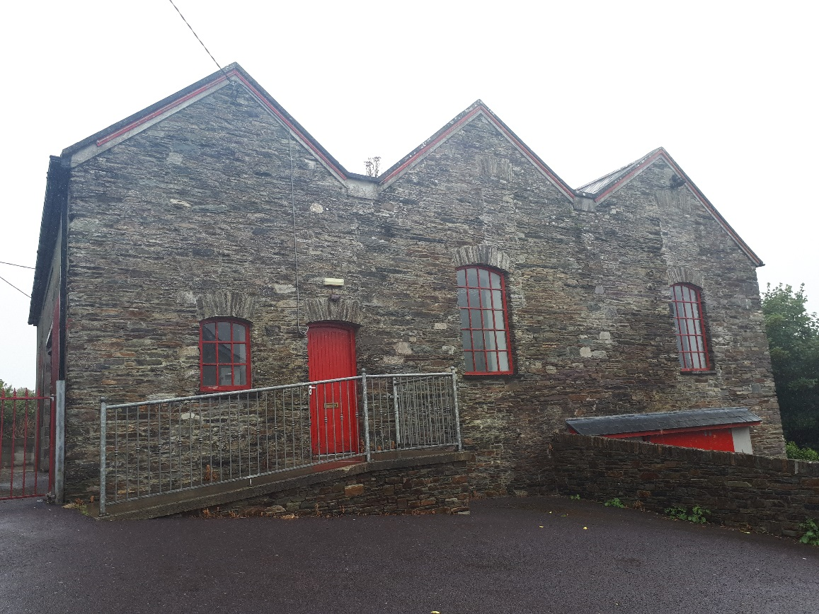
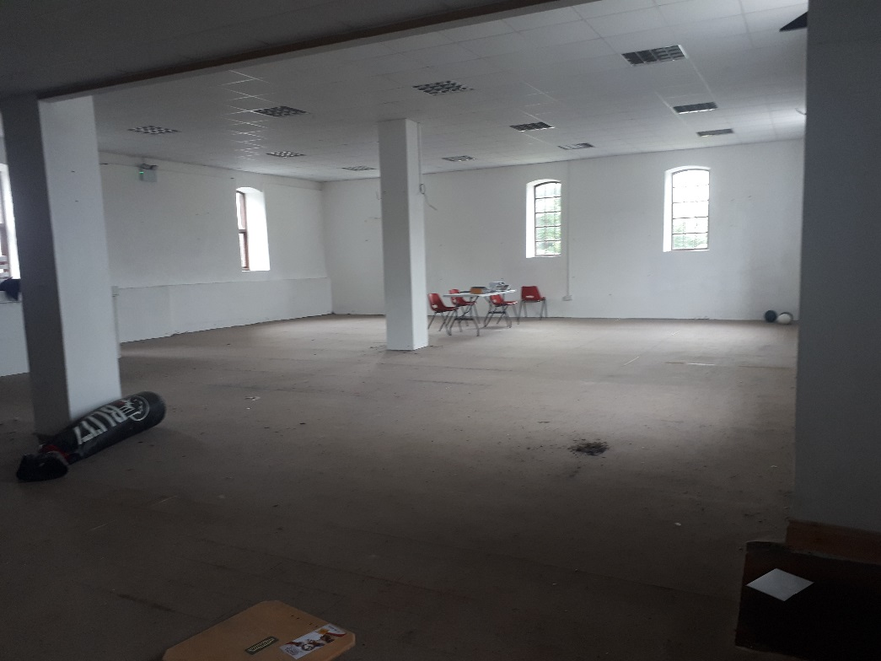
Example of Social Innovators: Skibbereen Family Resource Centre

Slide 9

Example of Social Innovators: Ballinadee Community Council

Slide 10
Enabling (Animating) Cross-Community
Social Innovation
- SECAD Approach 2018 +
Example: ‘Passage West’

Slide 11
Passage West – At the Mouth of River Lee and Opening of Cork Harbour
(2nd Deepest Harbour in the World)

Slide 12
Passage West – Industrial Heritage - ‘Heavy’ Industry

Slide 13
Needs a ‘face lift’ – New Life? Where is it going to come from? And Who
will take Responsibility?

Slide 14
Danger of Destruction of Architectural Heritage – Impact on Social and Economic Resilience

